Slide 1



Welcome!
Aligning the Food System for Improved Nutrition in Animal Source Foods

Slide 2
Helene Dillard
Dean
College of Agricultural and Environmental Sciences, UC Davis
Aligning the Food System
for Improved Nutrition in Animal Source Foods
May 14-15, 2019
UC Davis

Slide 3
Ermias Kebreab
Associate Dean of Global Engagement and Director of the World Food Center
College of Agricultural and Environmental Sciences, UC Davis
Christine Stewart
Interim Director of the Program in International and Community Nutrition, UC Davis
Aligning the Food System
for Improved Nutrition in Animal Source Foods
May 14-15, 2019
UC Davis

Slide 4



Thank you to our sponsors:

Slide 5
WiFi Access Information
Set your devise to search for available WiFi networks
Connect to ucd-guest network
Open a web browser and follow the WiFi access instructions
Need help with this or anything else?
Stop by the registration desk anytime.
Aligning the Food System
for Improved Nutrition in Animal Source Foods
May 14-15, 2019
UC Davis

Slide 6
Anna Lartey
Director, Nutrition and Food Systems Division
Food & Agriculture Organization (FAO), United Nations
Aligning the Food System
for Improved Nutrition in Animal Source Foods
May 14-15, 2019
UC Davis

Slide 7
Animal Source foods within a sustainable food system that delivers on Healthy diet
Anna Lartey
Director, Nutrition and Food Systems Division
Food and Agriculture Organization of the UN, Rome
A presentation at:
UC Davis: World Food Center/ Dept of Animal Science /
Prog in International and Community Nutrition
14 May, 2019

Slide 8
Outline
Food system challenges
Impact on global nutrition situation
Animal Source food: Production and consumption
Animal source foods within a sustainable food system that delivers on healthy diet
Conclusions

Slide 9
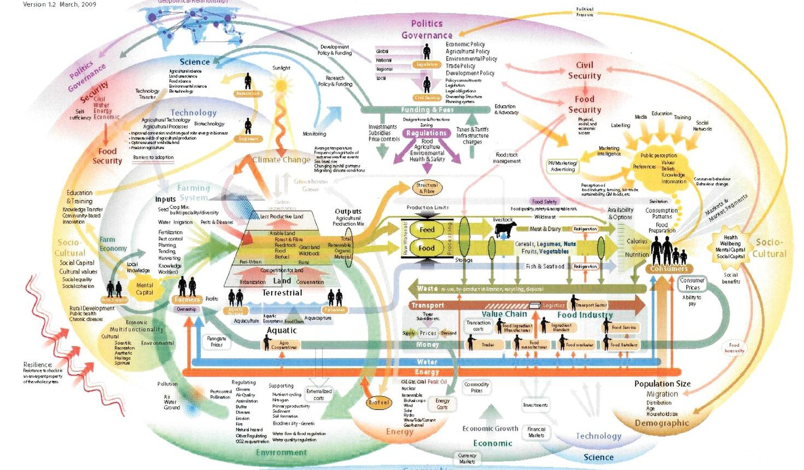
Healthy diets are not the Default
Food environments are shaped by food systems
C. Hawkes, 2009
Notes:
…However given the alternative…I decided that some oversimplification was probably the best way to go!

Slide 10
Healthy diets are not the Default
Food environments are shaped by food systems
Food System
Production, processing, retail, consumption , disposal
Food Environment
Availability, access, convenience, desirability for consumers
Individual Diet Quality
Diversity, adequacy, safety
Source: Meerman 2015
Notes:
Food Environment is the place where consumers make a decision about what to buy and order. FE is influenced by consumers desires- taste, culture income, religion;
FE also influences our decision by the types of foods available, the brands, whether organic or inorganic, GMO or non GMO; advertising, etc

Slide 11
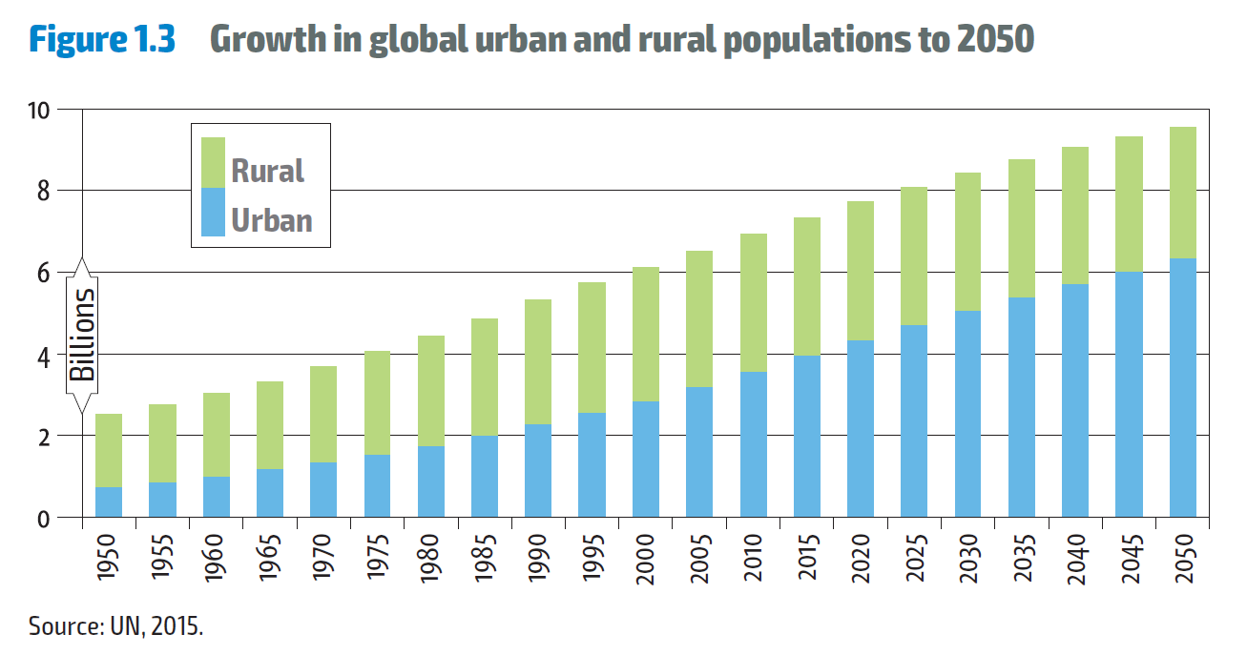
Urban and rural populations
Notes:
With the population growth will also come urbanization.

Slide 12
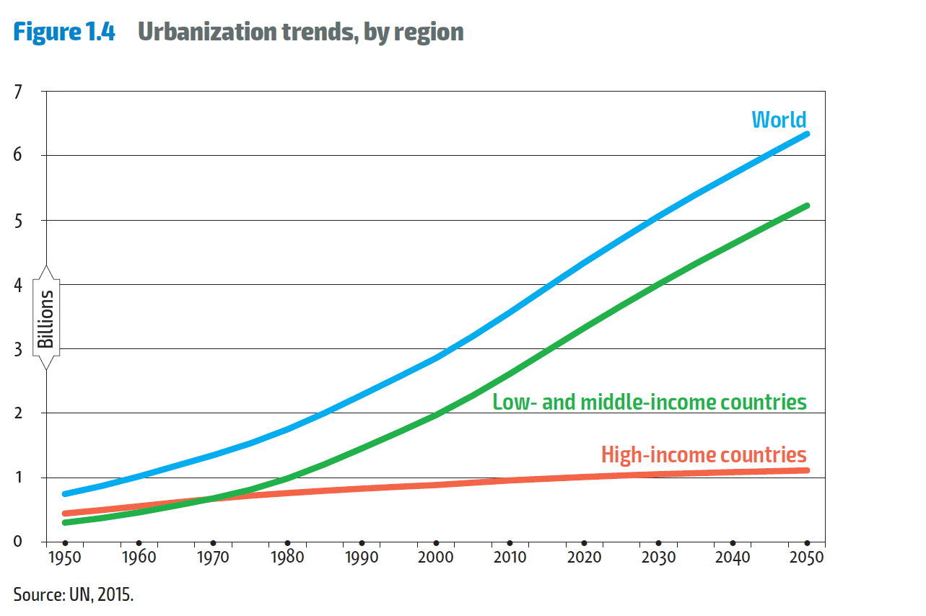
Urbanisation in low- and mid income countries

Slide 13
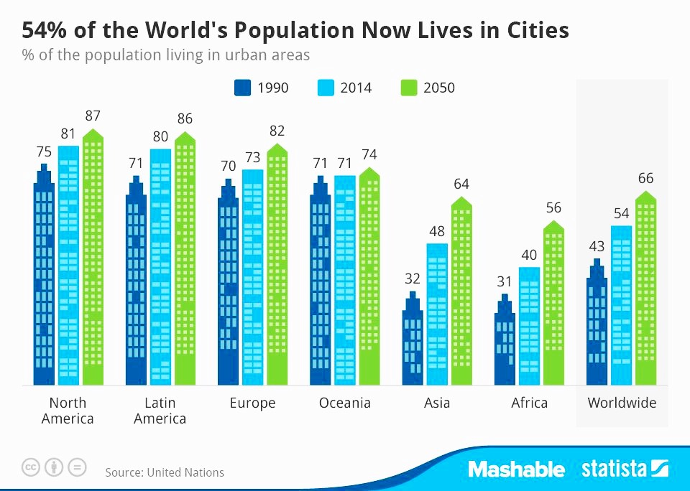
By 2050, most of the world is urbanized
Sources: United Nations, Department of Economic and Social Affairs, Population Division (2017).

Slide 14
The number of extreme climate-related disasters
has doubled since the early 1990s
^{6 / 11}
Notes:
In many areas around the world, climate has become more variable and climate extremes have increased in number and intensity
Temperatures are increasing and becoming more variable. Very hot days are becoming more frequent and the hottest days are becoming hotter.
We are experiencing large spatial variability in rainfall, both significantly above- and below- normal
The nature of rainy seasons is also changing, specifically in terms of start, length and intensity of the rains. .
The figure shows that the number of extreme climate-related disaster events has doubled since the early 1990s (extreme heat, droughts, floods and storms)
which means we now experience on average 213 medium and large climate-related catastrophic events every year
Climate-related disasters account for more than 80 percent of all major internationally reported disasters
Climate variability and extremes are already negatively undermining the production of major crops in tropical regions.
So climate variability and extremes, are not only events that will happen in the future; they are occurring now and are contributing to a rise in global hunger.

Slide 15
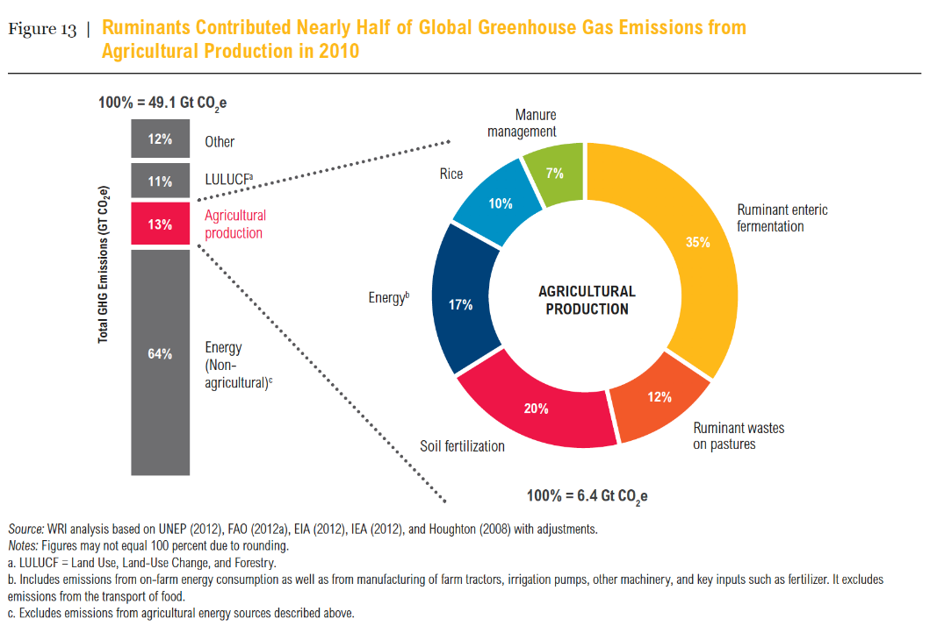
Not Sustainable
Ruminants contribute ~50% of GHGe from ag production
Source: Ranganathan, J. et al. 2016. “Shifting Diets for a Sustainable Food Future.” Working Paper, Installment 11 of Creating a Sustainable Food Future. Washington, DC: World Resources Institute. Accessible at http://www.worldresourcesreport.org

Slide 16
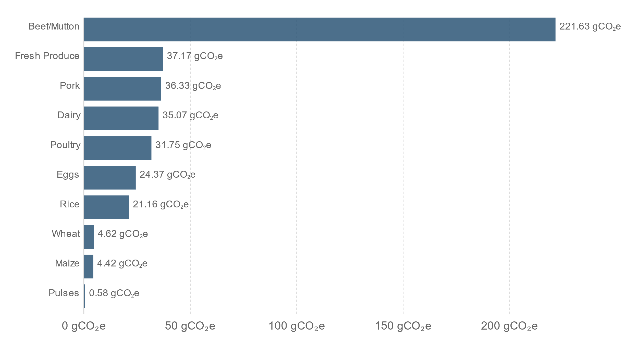
Greenhouse gas emission per gram of protein, by food type.
Source: Clark and Tilman, 2017
Notes:
Greenhouse gas emissions per gram of protein, by food type
Average greenhouse gas emissions per unit protein, by food type measured in grams of carbon dioxide equivalents (CO₂e) per gram of protein. Average values are based on a meta-analysis of studies across 742 agricultural systems and over 90 unique foods.

Slide 17
The majority of chronically food insecure people live in countries affected by conflicts
Source: SOFI 2017, FAO et.al

Slide 18
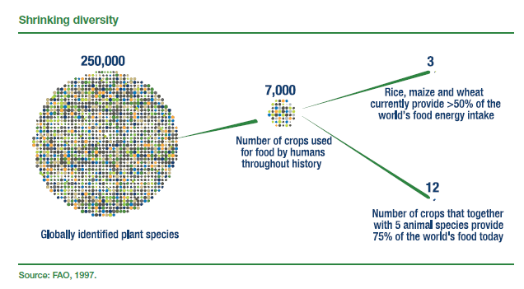
Very little diversity in the way we eat now

Slide 19
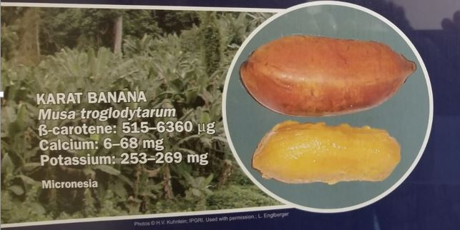
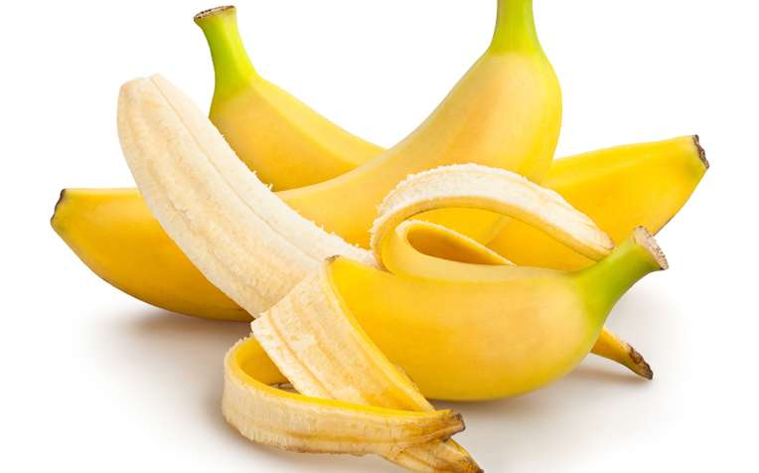
Utin lap Banana
B-carotene content= 8508 mcg/100g
Banana intake (g/d/p) = 93
RDI for Vit A covered = 220%
by banana intake (%)
Cavendish Banana
B-carotene content= 26 mcg/100g
Banana intake (g/d/p) = 93
RDI for Vit A covered = 0.7%
by banana intake (%)
Notes:
Not only have we lost diversity but also nutritional quality. The case of indigenous banana being extremely high in vitamin A vrs the beautiful cavendish banana we all like so much but hardly any vitamin A.

Slide 20
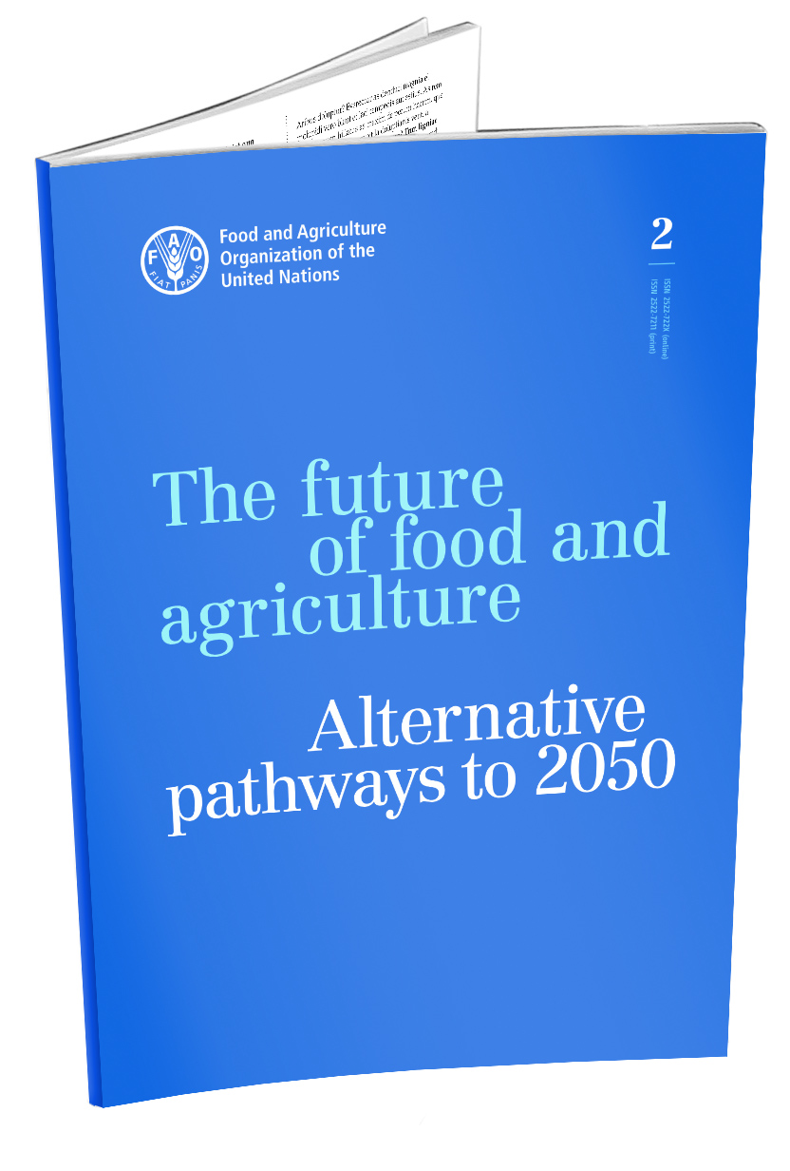
Will Global Food and Agricultural systems be able to feed Humanity sustainably by 2050 and beyond? –
Alternative pathways to 2050
Notes:
This report presents a foresight exercise to identify potential strategic options for achieving the SDG concerning food and agriculture.
The report analyses the potential future scenarios that reflect to varying degress, the challenges to move food and agricultural systems towards “a world in which food is nutritious and accessible for everyone and natural resources are manged in a way that maintain ecosystem functions to support current as asll as future human needs”
“Will global food and agricultural systems be able to feed humanity sustainably and satisfactorily in the future, while also accommodating additional non-food agricultural demand?
Ensuing questions:
What can be done to manage food demand and orient people’s dietary preferences towards more nutritious and less resource-intensive food?
How to address the scarcity and reduced quality of land and water resources in a sustainable manner?
Will poverty, inequality and unemployment continue to constrain food access and hamper the achievement of food security and nutrition goals?
How will climate change affect agriculture and rural livelihoods, and can agriculture help reduce GHG emissions?
The whole report is shaped to address these concerns and to analyze related challenges.
The challenges food and agricultural systems are facing, where highlighted in the previous FAO report FOFA TAC (SHOW)
FOFA 2050 takes stock of those challenges and has the ambition to shed some light on them
In an effort to identify a solid analytical framework, required to shed light on the future of food and agriculture, those challenges have been grouped in two broad families:
Challenges for the future availability and stability of food and other agricultural commodities
Challenges for access to good quality, nutritious food, and its proper utilization

Slide 21
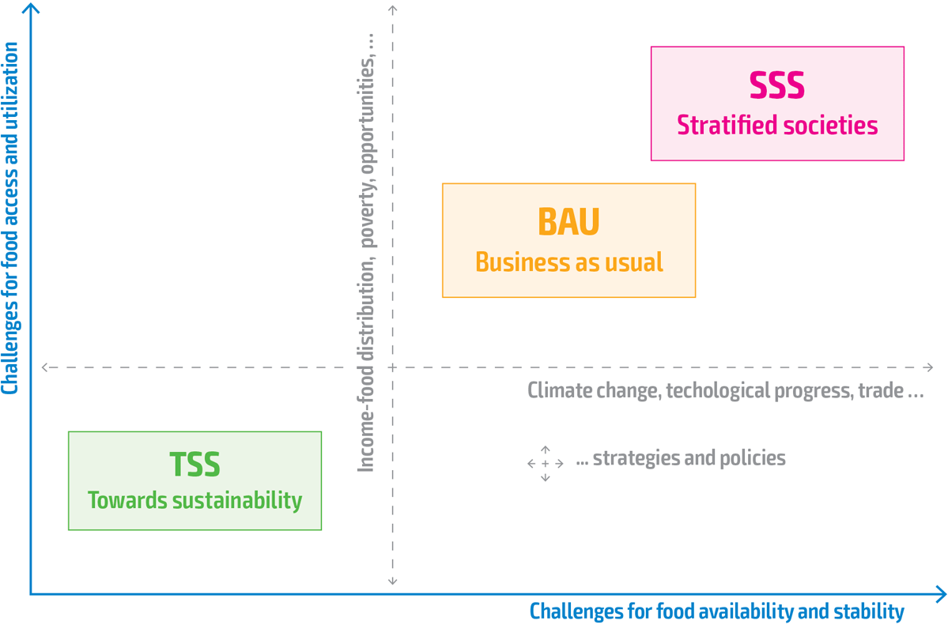
Challenges space for food security, nutrition and sustainable agriculture
Notes:
The “Business as usual scenario” (BAU)- where several outstanding challenges facing food and agriculture are left unaddressed.
The “Towards Sustainability scenario” (TSS)- involves proactive changes towards more sustainable food and agriculture systems.
The “Stratified Societies scenarios” (SSS)- Outlines a future with exacerbated inequalities across countries and throughout different layers of societies.
The three scenarios for FOFA 2050, Business as Usual, Towards sustainability and Stratified Societies, have been cast in this “Challenges space”, which is the challenges space for sustainable food security, improved nutrition and sustainable agriculture and rural development.
This can be seen as the space of challenges we face to achieve the targets of SDG2.
Drivers of food and agricultural systems, such as per per-capita income, income earning opportunities, income distribution, poverty may increase or decrease the challenges for access and utilization of food, depending on their future pattern.
Other drivers, such as population growth, technical progress, climate change, may increase or decrease the challenges for availability of agricultural (food and non food) products and their long term stability
Needless to say, some drivers may influence both the families of challenges.
In this challenges space, not only drivers per se influence the future, but also most, if not all strategies and policies that countries, regions and the global development community will adopt and implement to achieve SDG-related targets.
Policies and strategies (or missed policies and strategies) act as enablers (shifters) of the future of food and agricultural systems towards more or less (stronger or weaker) challenges for food security and nutrition in one direction or the another. Just for example: elimination of extreme poverty (SDG1), improve water efficiency (SDG 6), Improve working conditions and sustainable economic growth (SDG 8), reduce inequality (SDG 10); Responsible production and consumption (SDG 12, halve food waste 12.3), combat climate change (SDG 13) protect life below the water (14) and not less important, as portrayed in SOFI 2017, fight for peace, justice and strong institutions (16)
Note that, in designing this FAO FOFA 2050 long-term foresight exercise we did not start from scratch. We borrowed the idea of the “challenge space” from the approach adopted in foresight analyses that support the work of the Intergovernmental Panel on Climate Change (IPCC) in its fifth assessment report AR5, which designed their futures in the space of “challenges for adaptation to climate change” and challenges for mitigation of climate change.
We borrowed part of the narratives from the Shared Socio-economic Pathways (SSPs) used by IPCC, as well as climate change scenarios based on the “Representative Concentration Pathways” of AR5.
Still, we had to adjust narratives, select drivers and shape our quantitative analysis to highlight challenges for food security, nutrition and sustainable agriculture

Slide 22
The three FOFA 2050 scenarios in a nutshell
 | Business as usual (BAU) | Towards Sustainab. (TSS) | Stratified societies (SSS)
Economic growth (per capita) | Moderate (1.3% per year to 2050) but uneven. | As BAU globally, but favoring LMIC | Sustained but skewed against Sub-S. Africa
International governance/conflicts | Limited progress. Conflicts increase | Towards more just and peaceful societies | Inequality and resource grab boost conflicts
Human development | LIC progress is limited in basic services | Universal access to basic services almost ensured | Very skewed within and between countries
Energy, GHG emission | Fossil fuels prevail and GHG unabated at best | Circular economies, fossils fuels/GHG limited | Fossil fuel-based growth boosts GHG emissions
Land and water use | Arable land and land degradation expand | Limited expansion due to innovative technology | Strong increase, degrad. and deforestation
Agricultural innovation | Some innovation but not evenly distributed | Innovative technology due to investment in RD | Limited, labour saving but no resource-saving
Welfare and inequality | Persistent poverty and inequality little FSN progress | Less poverty and inequality and more FSN | More poverty and inequality and less FSN
Source: FAO, 2018. The future of food and agriculture – Alternative pathways to 2050. Rome.
Notes:
Notes
BAU is inspired by the IPCC Shared Socioeconomic Pathway 3 used by the Intergovernmental Panel on Climate Change in its 5th Assessment report (2013-2014), TSS is inspired by SSP 1 and SSS by SSP4. In all the tree scenarios demographic dynamics are kept constant to favour comparisons.
Economic growth and related policies:
BAU: Long term cross-country convergence is doubtful due to different volumes of investment, including in research and development. Technological disparities and diverging demographic dynamics. Foreign investment continues along the north-south axis with limited gains for locals. Domestic savings rates higher in HICs. International trade led by few actors. Fiscal policies continue to provide some within-country redistribution, but incentives to move towards sustainability are limited.
TSS: Globally, GDP per capita grows as in BAU but, comparatively, the growth rate is lower in High Income Countries (HIC) and higher in Low- and Middle Income Countries (LMIC). Foreign investment is higher than in the BAU scenario, with positive impacts on local incomes. Domestic savings increase and help to finance investments in innovative technologies.
SSS: Overall, economic growth is respectable, but immiserizing growth mechanisms are present. GDP per capita grows at a faster rate than in BAU, at around 2 percent per year, but is faster in HIC and lower in LMIC when compared against growth rates of the BAU scenario.
International governance and conflicts
BAU: The goals of promoting just, peaceful and inclusive societies, and significantly reducing illicit financial and arms flows as well as bribery and corruption, are only partially achieved due to limited effectiveness of institutions at all levels to set up and enforce standards and regulations.
TSS: The goals of promoting just, peaceful and inclusive societies and significantly reducing illicit financial and arms flows, bribery and corruption are mostly achieved through improved governance
SSS: Illicit financial flows expand and bribery and corruption distort the decision-making of public officials, thereby favouring the elite. ODA declines drastically and fiscal systems weaken globally. Conflicts over natural resource control intensify amid permanent global instability, but the international elite prevent collapse
Human development
BAU: Countries are barely able to provide quality education. Access to health services is an ongoing challenge, and low-income countries (LIC) are sometimes unable to maintain their populations’ well-being. LIC struggle to maintain access to water and sanitation. Many forms of discrimination against women and girls are brought to a permanent end, but labour market discrimination persists in many countries
TSS: Universal access to drinking water and sanitization is permanently achieved. Social welfare increases, thanks to universal primary and secondary education, universal access to health services, lower unemployment, lower wage differentials and widespread access to non-material public goods (e.g. inclusiveness, empowerment, security).
SSS: Well-educated, internationally-connected social classes contrast with lower-income, poorly-educated social classes. Even in HIC, the poor do not have access to quality health services. Education levels are highly stratified between income groups and countries. Diets and access to food worsen for most people, due to lower purchasing power and consumer awareness.
Energy use and GHG emissions
BAU: Fossil fuels are the main energy source for decades, with renewable sources slowly emerging. Oil extraction rates remain relatively unchanged. The potential for GHG sequestration is limited, as uncertainty regarding future economic incentives limits R&D and the adoption of suitable practices.
TSS: Recycling becomes the primary form of raw material supply, leading to declining extraction rates. The potential for GHG sequestration is high due to suitable crop technologies, reforestation and afforestation. Widespread conservation practices and increased R&D investments lead to a sharp decrease in GHG emissions.
SSS: Limited investments flow to R&D and the intensive use of chemicals and land in agriculture, as well as fossil fuels economy-wide, all contribute to very high levels of GHG emissions.
Land and water use
BAU: Arable land (the physical area under temporary and permanent agricultural crops) expands at faster annual rates than in the last decades and land degradation is only partially addressed. Land intensity, which is to say the quantity of land per unit of output, decreases as crop and animal yields increase, but these achievements require the progressive use of chemicals.
TSS: Low-input processes lead water intensity to substantially decrease and energy intensity to substantially improve against the levels seen under the BAU scenario. Regarding land-use intensity, the quantity of land per unit of output drops with respect to current levels, thanks to sustainable agricultural intensification and/or other practices aimed at improving resource efficiency.
SSS: The world suffers further deforestation. New agricultural land is used to compensate for increased degradation and to satisfy additional agricultural demand, which is left unmanaged.
Agricultural innovation
Innovation is generated through high investments in research following historical trends, with a reduced role of the public sector. However, family farmers do not necessarily benefit due to costly input packages that have dubious effectiveness or environmental sustainability.
TSS: Boosted investment ensures the transition towards a more sustainable use of natural resources and climate change mitigation compared to BAU. Low-input precision agriculture, agroforestry, intercropping, and organic agriculture and/or other resource and climate-friendly production methods contribute to moving towards “circular” economies, that is economies based on reusing goods and recycling waste, with limited impacts on ecosystems.
SSS: Agriculture follows diverse paths, with the coexistence of subsistence agriculture, low-quality commercial agriculture for mass consumption under concentrated control, and high-quality and luxury niches present in both HIC and LMIC. Innovation focuses more on labour-saving technologies than on sustainability. Regulations on inputs are relaxed, including on both quantity and type of herbicides, hormones, antibiotics, and other chemicals used for mass production, while agricultural input markets become increasingly concentrated, with progressively expanding oligopolies.
Welfare and inequality
BAU Current moderate trends of extreme poverty reduction are maintained, and moderate food security improvements occur. Nevertheless, “zero hunger” and “no malnutrition” are not achieved by either 2030 or 2050. In terms of diets, current trends of moderate convergence towards the consumption of more nutritious food are maintained,
TSS: Extreme poverty reduction targets are achieved by 2030 due to pro-poor investment and development, and food security and malnutrition improvements suggest more progress towards achieving “zero hunger” by 2030 compared with the BAU scenario, with developments further improved thereafter. Balanced, healthy and environmentally-sustainable diets are increasingly adopted, also thanks to better income distribution.
SSS: The declining trends in hunger and malnutrition are reversed, particularly in countries with high population growth, Poverty increases in HIC, and overall trends in both poverty and extreme poverty reduction are reversed, also due to increasing inequalities within ad between countries.

Slide 23
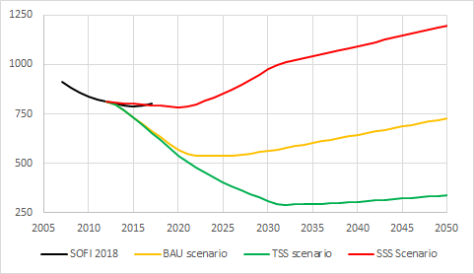
Where are we going? The no of Undernourished so far compared to 2050
Million of people
undernourished
Source: FAO, 2018. The future of food and agriculture – Alternative pathways to 2050. Rome. And
FAO, IFAD,UNICEF, WFP, WHO 2018. The State of Food Security in the World, 2018. Rome
Notes:
With the TSS there is the urgency to invest in technologies that will move us towards sustainability.
SSS= Unequal scenarios
Note that environmental sustainability and elimination of hunger are not
Contradicting each other.
Comparison with IPCC (Intergovernmental Panel for Climate Change)
BAU = SSP3; TSS= SSP1; SSS=SSP4

Slide 24
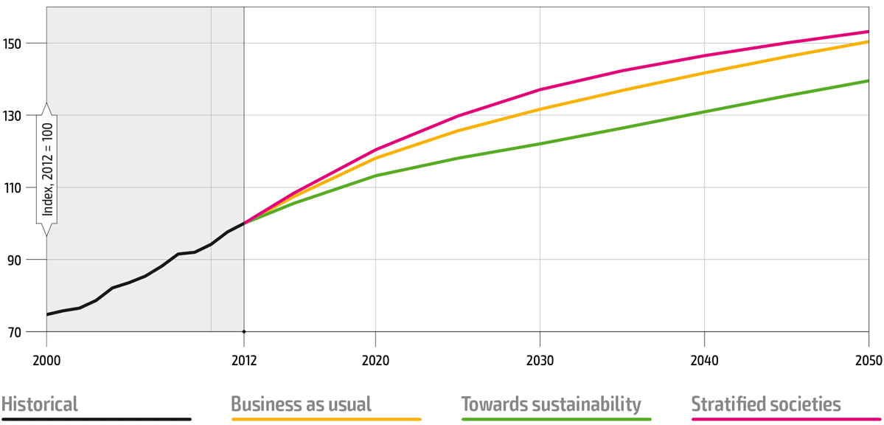

Gross agricultural output
+54%
+50%
+40%
Notes:
2012 = 100% (baseline)
According to the (ex-ante) evidence provided in FOFA 2050, the answer is no, quite the opposite: by 2050
BAU +50% (50%)
SSS +53% (54%)
TSS +40% (40%)
How is it possible?
A key message emanating from the accurate quantitative analysis and qualitative assessments is that to meet the SDG targets for ending hunger and achieving food security and better nutrition can be achieved with a much lower output than in BAU as long as production systems are more sustainable, on the one hand, and income and food are more equitably distributed across and within countries, on the other.
With TSS: We need to invest in technologies to enable to produce more with less.

Slide 25
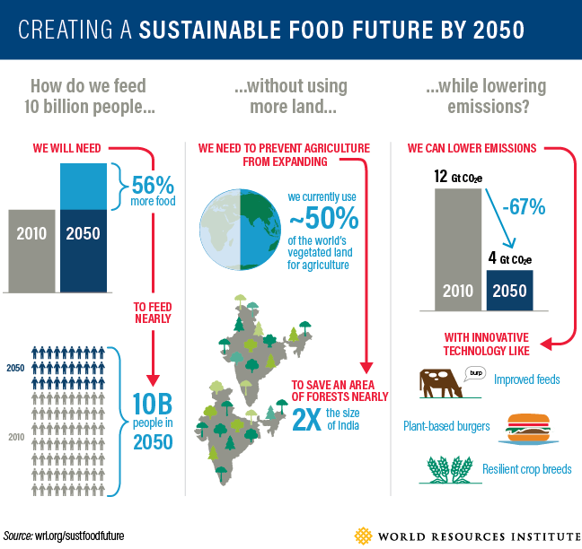
wri.org/sustfoodfuture | World Resources Report: Creating a Sustainable Food Future
Notes:
Other Organizations have also asked the same questions:
How do we feed 10 billion people .. Without using more land… and while lowering emissions?
Towards sustainability path is not an option it is the way to go!!

Slide 26
Source: C. Bene et al. 2018
World Development https://doi.org/10.1016/j.worlddev.2018.08.011

Slide 27
“Hunger” (chronic undernourishment) is still on the rise
The most recent evidence points to a further increase.
821 million people are estimated to be undernourished in 2017
^{2 / 11}
Notes:
New evidence continues to signal a rise in world’s hunger
The number of undernourished people on the planet has increased to 821 million, up from 804 million in 2016.
The percentage of undernourished people in the world also increases: it is estimated that 11 percent of the global population, that is, one in nine people in the world, is chronically undernourished.
The situation is worsening in South America and most regions of Africa, while the situation has changed little in most regions of Asia.
This is largely attributed to persistent instability in conflict-ridden regions, adverse climate events that have hit many regions of the world and economic slowdowns that have affected more peaceful regions and worsened the food security situation.
Last year’s SOFI presented an in-depth look at the role of conflict as one of the drivers behind the rise in hunger; in this year’s report we look more deeply at the role of climate – and specifically climate variability and extremes.

Slide 28
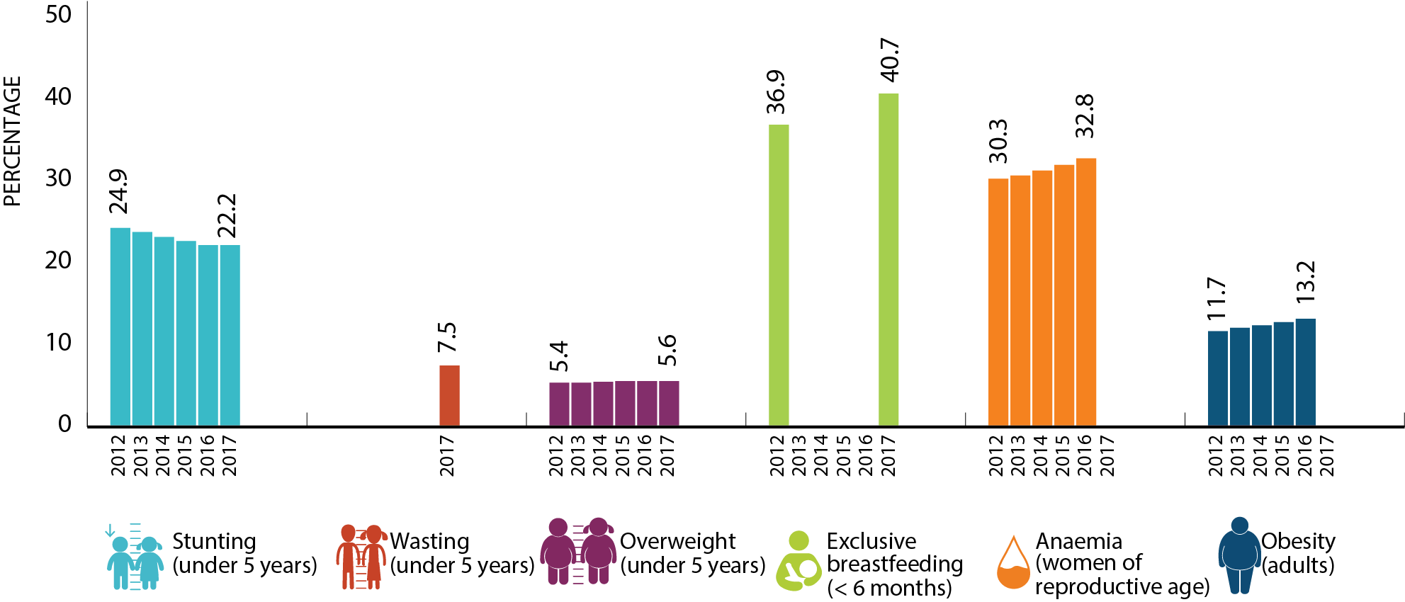
Chronic child malnutrition (stunting) continues to fall and more infants are being exclusively breastfed in their first 6 months of life
However, rates of adult obesity and anaemia in women of reproductive age are increasing
^{3 / 11}
Notes:
The worrisome trend in world hunger is not reflected in chronic child malnutrition (stunting) as this continues to fall, although at a slower rate in several regions.
Nearly 151 million children under five in the world – or 22 percent – were still stunted in 2017, down from 25 percent in 2012.
How do we reconcile the existence of these apparently paradoxical results in which food insecurity is on the rise, while child stunting is improving?
Food insecurity is only one determinant of nutritional outcomes, especially for children.
For example, key determinants of child stunting and wasting are poor maternal health and nutrition before and during pregnancy and lactation, inadequate breastfeeding, poor infant and child feeding practices, and lack of access to clean water, sanitation and quality health care.
Over 50 million children under five are affected by wasting, meaning they are too thin for their height. Roughly half of those children live in Southern Asia and one quarter in sub-Saharan Africa.
Nearly one in ten children in Asia and Oceania are affected by wasting, compared to just one in one hundred in Latin America and the Caribbean.
Levels of overweight in children under five years of age have remained nearly the same since 2012 in all regions of the world. Currently 38 million children under five in the world are overweight.
However adult obesity continues to rise. Currently, more than one in eight (13 percent) adults in the world is obese a total of 672 million adults.
Adult obesity is highest in Northern America, but obesity is on the rise even in Africa and Asia, which currently have the lowest levels.
Multiple forms of malnutrition coexist, with countries experiencing simultaneously high rates of child undernutrition, child overweight, anaemia among women and adult obesity. These multiple forms of malnutrition – including forms of undernutrition as well as obesity – are found even in the same household but also on the same individual at different periods of his or her life.

Slide 29
Many improvements in human well-being
Malnutrition
Communicable diseases
Famine deaths
Illiteracy
Mortality
Poverty
1990
2015

Slide 30
Food System is not delivering on the healthy diets needed for optimal health

Slide 31
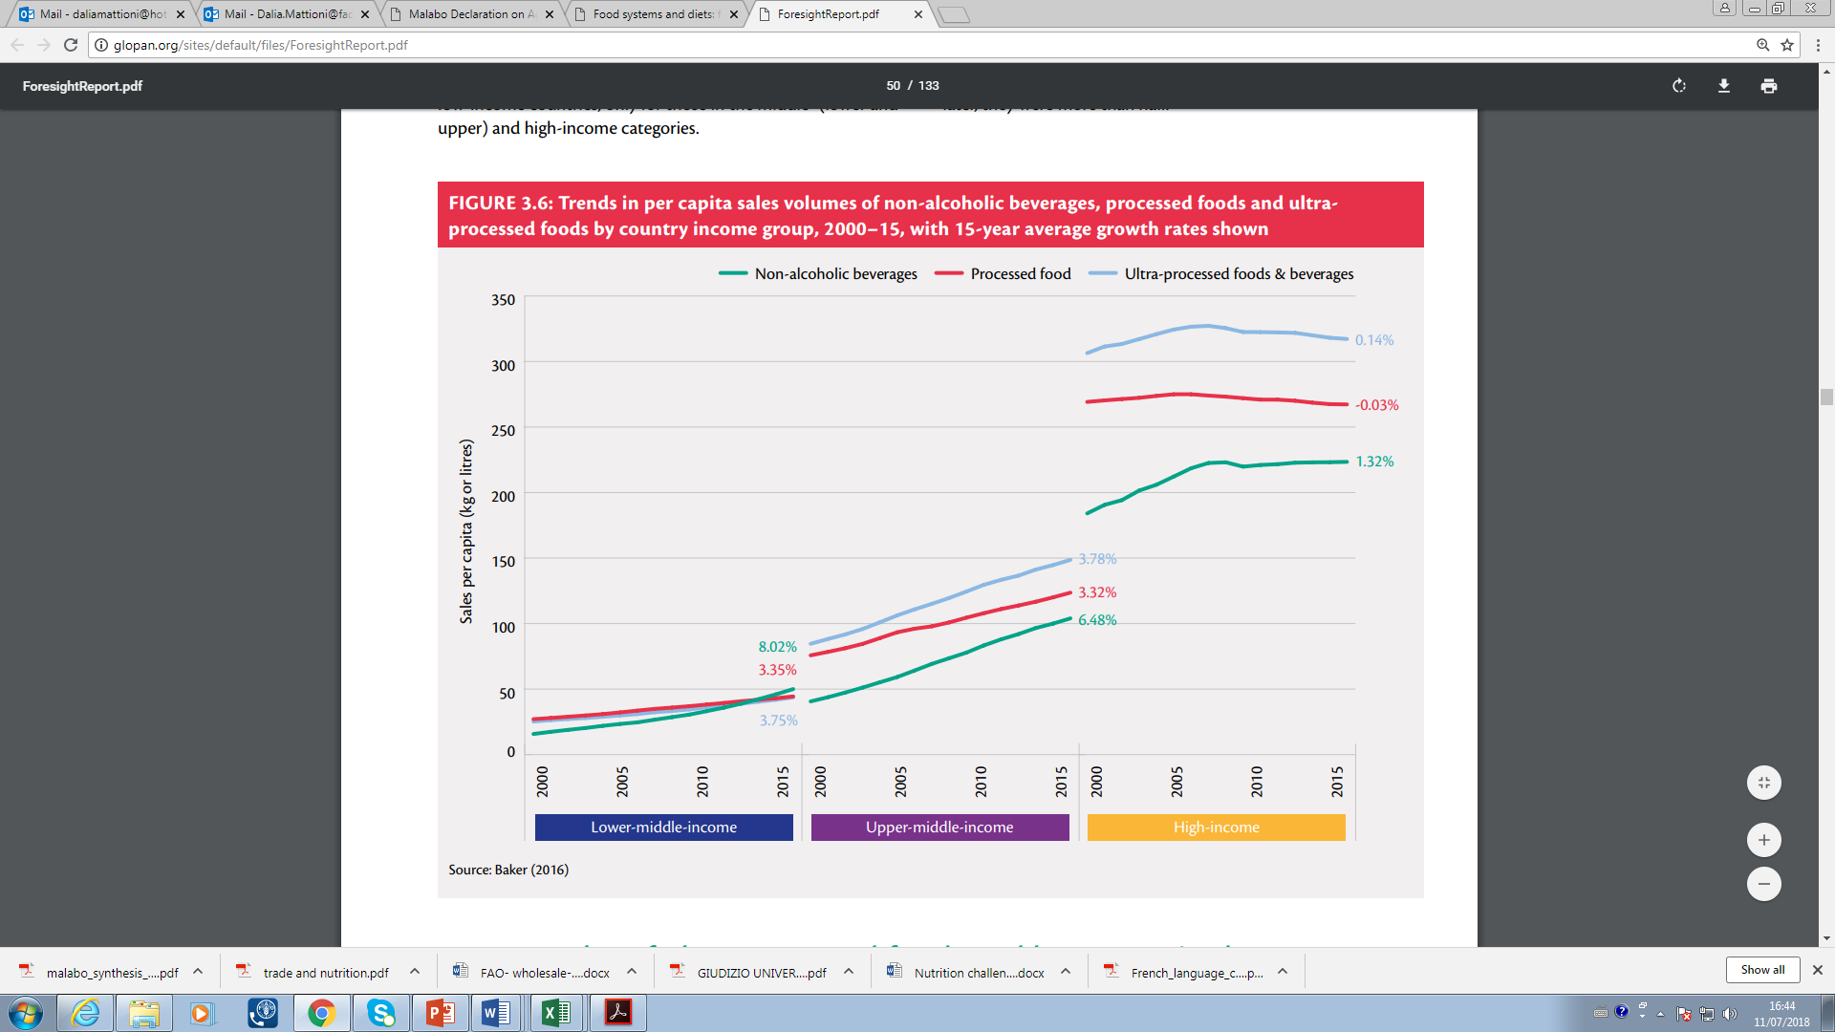
Trends in per capita sales volumes of non-alcoholic beverages, processed foods and ultra-processed foods by country income group, 2000–2015
Global panel 2016

Slide 32
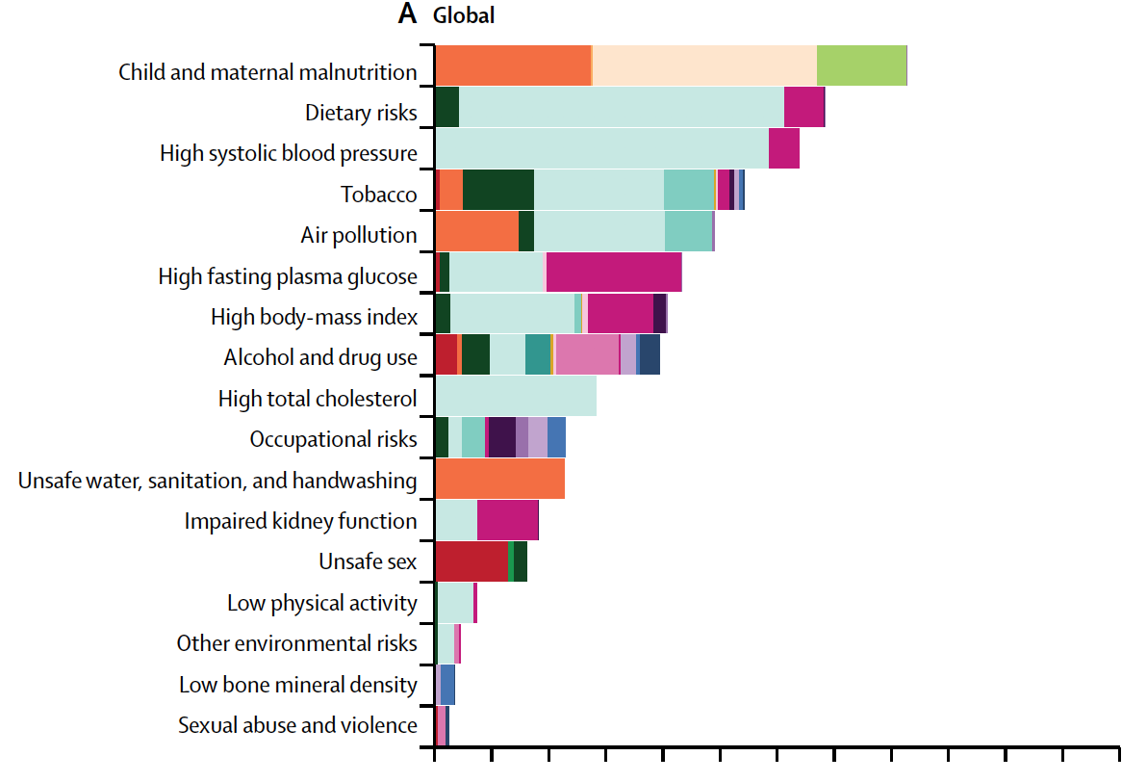
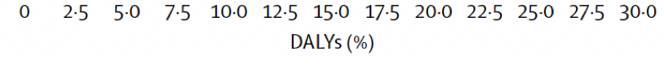
Big Contributor to the Disease Burden, is…Food!
Source: GBD 2016 Risk Factors Collaborators (2017). Global, regional, and national comparative risk assessment of 84 behavioural, environmental and occupational, and metabolic risks or clusters of risks, 1990–2016: a systematic analysis for the Global Burden of Disease Study 2016. Lancet
Notes:
Suboptimal diet was the second-leading risk factor for deaths and DALYs globally, accounting for 18·8% (16·0–21·7) of all deaths and 9·6% (8·2–11·1) of all DALYs.
Comparing men and women, suboptimal diet accounts for the greatest percentage of total deaths in men (19·0% [16·3–21·8]) and the second largest in women (18·6% [15·7–21·7]).
Meanwhile, suboptimal diet accounts for the second-largest percent of total DALYs in both men (10·6% [9·1–12·2]) and women (8·4% [7·0–9·9]).
More than 50% of deaths (51·5% [44·2–59·2]) and DALYs (54·1% [47·1–61·5]) attributable to suboptimal diet were due to cardiovascular diseases.

Slide 33
Global prevalence of overweight (BMI ≥25) and obesity (BMI ≥30) (among adults aged 18 years and over, 1990-2016
Source: NCD Risk Factor Collaboration / GNR2018

Slide 34
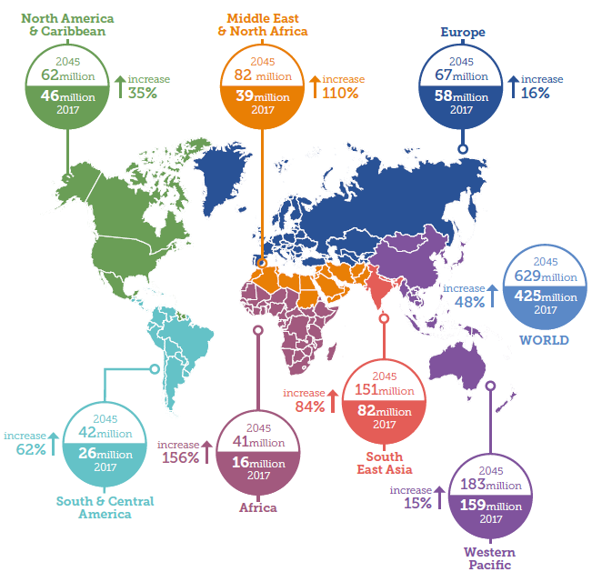
Diabetes: A global emergency
Number of people with diabetes worldwide and per region in 2017 and 2045 (20-79 years)
Adults with with diabetes, 2017 and 2045
2000 = 151 million
2017 = 425 million
2045 = 629 million
US$54 billion more spent
on treatment globally than in 2015
Diabetics 2-3x more likely
to develop CVD
Source: IDF Diabetes Atlas 2017

Slide 35
The Problem
If significant transformation is not made in our current food systems, this would be the first in human history when the next generation would have shorter life expectancy than their parents (Gostin, 2018).
* 1980 - 857 million persons were
overweight or obese;
* 2018 - 2.1 billion persons are overweight or obese
Unhealthy diets, now fueling the current obesity pandemic and increasingly NCDs has turned out to be the biggest cause of disease and death for humans in the 21st century.

Slide 36
Is there a role for ASF in a sustainable food systems that delivers on healthy diets?

Slide 37
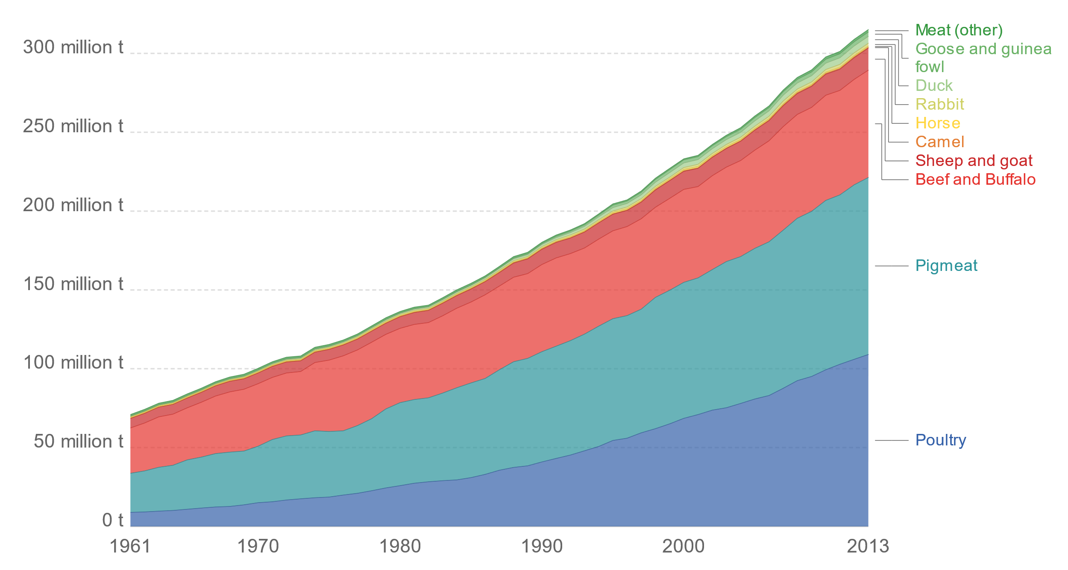
Meat production by Livestock type; Global
Source of Data: UN-FAO 2017; Ritchie H and Roser M, 2017
Notes:
Meat production by livestock type, World
Meat production by commodity or product type, measured in tonnes per year. All data shown relate to total meat
production, from both commercial and farm slaughter. Data are given in terms of dressed carcass weight, excluding offal
and slaughter fats.

Slide 38
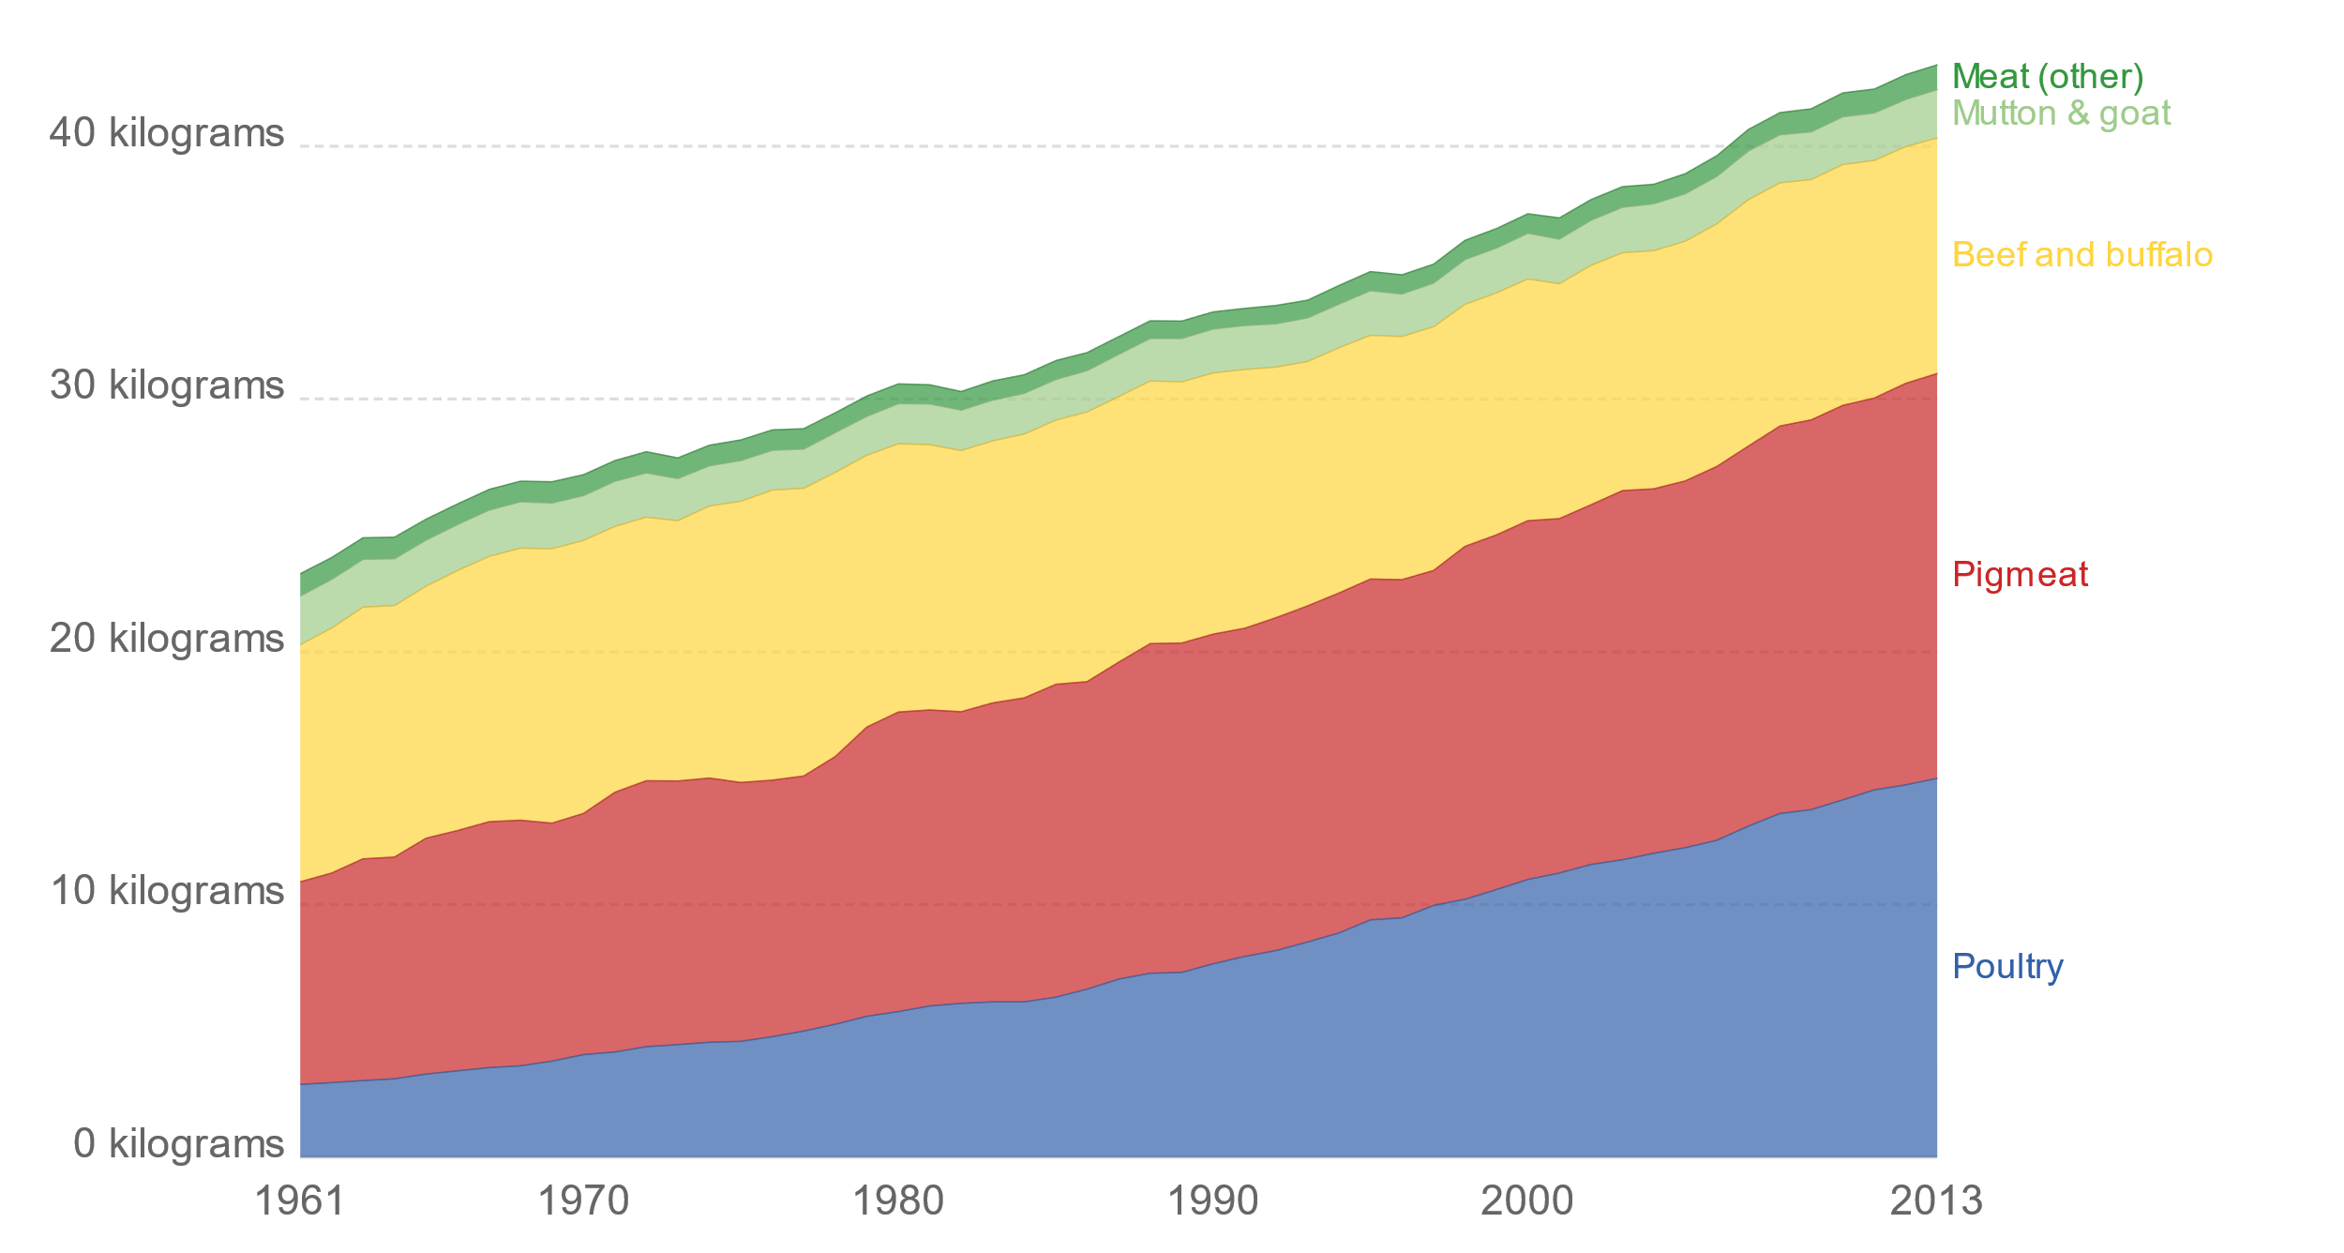
Per capita meat consumption by type, kg/year, 2013
Source of Data: UN-FAO 2017; Ritchie H and Roser M, 2017
Notes:
Per capita meat consumption by type, kilograms per year, World
Average per capita meat consumption broken down by specific meat types, measured in kilograms per person per year.
Data is based on per capita food supply at the consumer level, but does not account for food waste at the consumer
level.
Average per capita meat consumption broken down by specific meat types, measured in kilograms per person per year. Data is based on per capita food supply at the consumer level, but does not account for food waste at the consumer level.

Slide 39
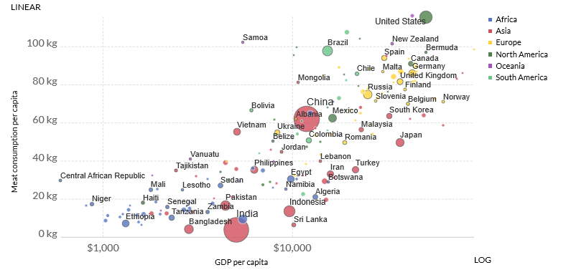
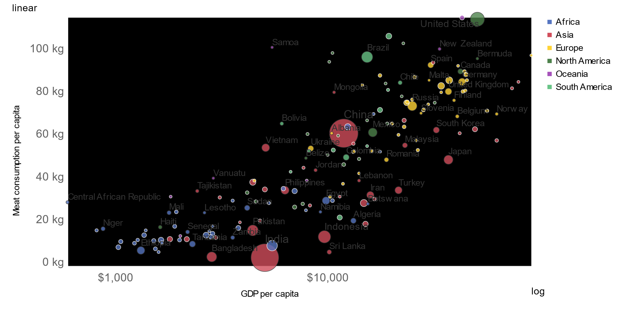
Meat supply per person, 2013
Source of Data: UN-FAO 2017; World Bank, World Development Indicators; Ritchie H and Roser M, 2017
Notes:
Meat consumption tends to rise as we get richer.
Average meat consumption per capita, measured in kilograms per year versus gross domestic product (GDP) per capita measured in 2011 international-$. International-$ corrects for price differences across countries. Figures do not include fish or seafood.

Slide 40
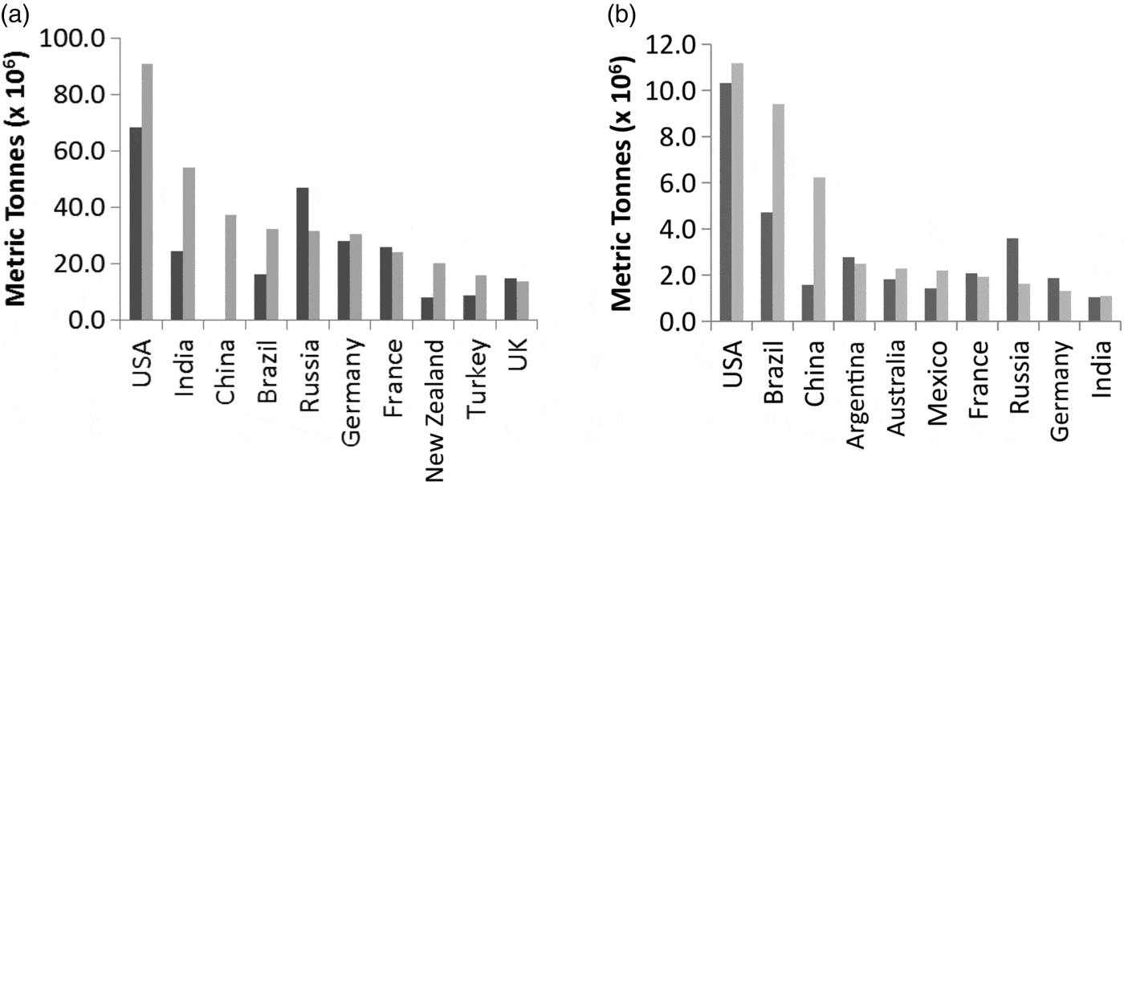
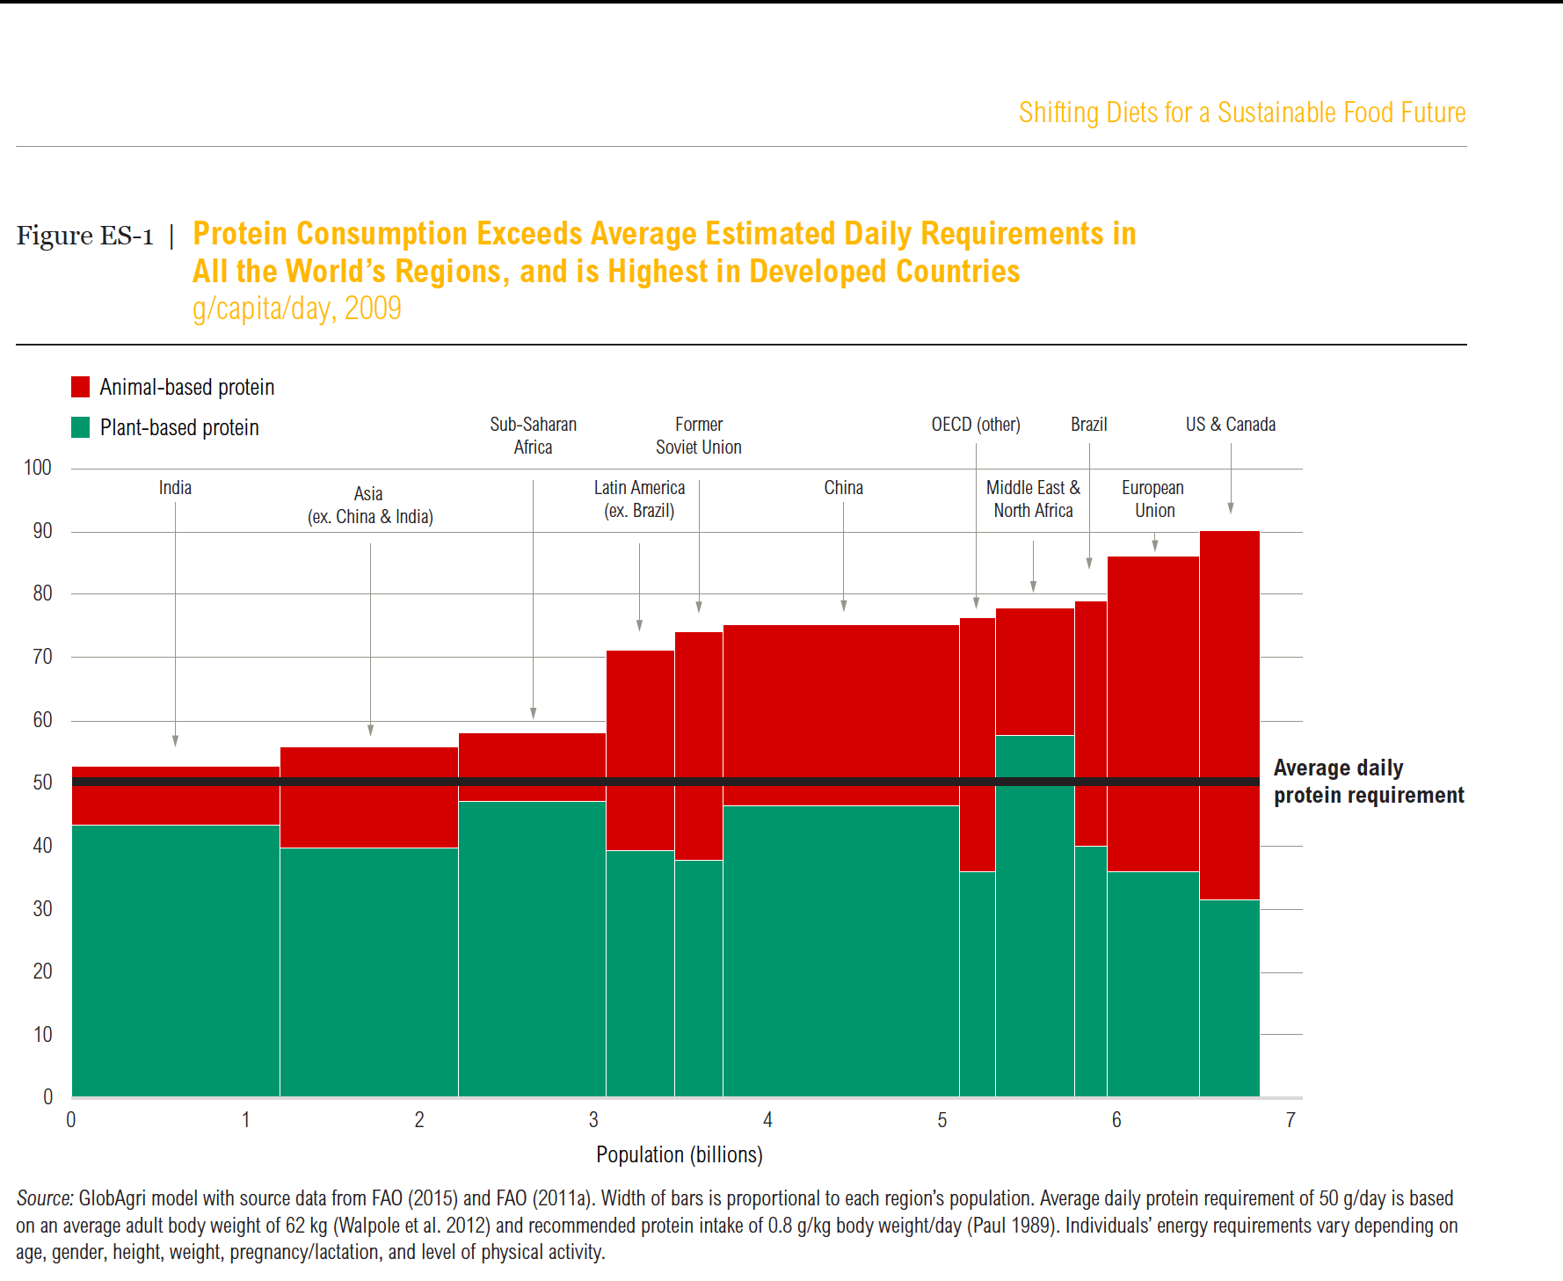


U.S. beef production and consumption are among the highest in the world
Beef production (metric tonnes)
Beef consumption (g/capita/day)
1992
2012
Source: FAO Stat 2018; GlobAgri model with source data from FAO, depicted by Ranganathan et al. 2016. Width of bars represents region’s population.

Slide 41
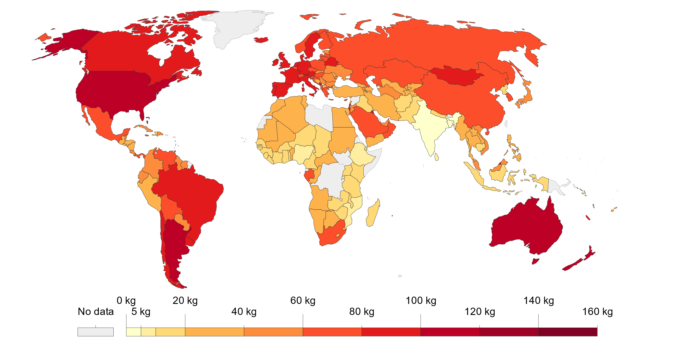
Meat supply per person, 2013
Average total meat supply person measured in kg per year. (fish excluded)
Source of Data: UN-FAO 2017; Ritchie H and Roser M, 2017
Notes:
Meat supply per person, 2013
Average total meat supply per person measured in kilograms per year. Note that these figures do not correct for waste
at the household/consumption level so may not directly reflect the quantity of food finally consumed by a given
individual.

Slide 42
World fish utilization and apparent consumption
Population (billions) and apparent fish consumption (kg/capita)
Fish utilization (Food/non-food uses)
(million tonnes live weight)
Excluding aquatic plants
Source: FAO: SOFIA 2018
Notes:
Loss or wastage between landing and consumption still accounts for an estimated 27 % of landed fish.
Since 1961 the annual global growth in fish consumption has been twice as high as population growth.
The sector’s relevance to economic growth AND to global development agendas is growing…

Slide 43
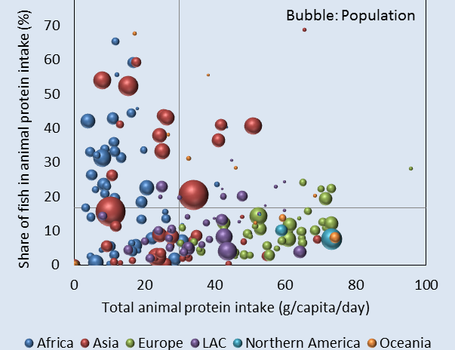
Fish is especially important in the diets of poor consumers
Source: FAO State of World Fisheries and Aqua culture 2018
Notes:
Fish plays a particular role as a source of animal protein in countries with a low total intake of animal protein.

Slide 44
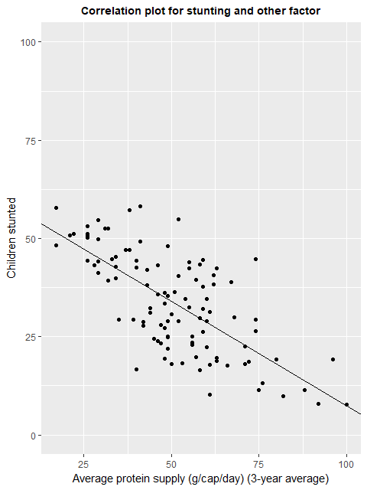
Correlation between Average protein supply (all sources) and stunting
Data: FAOSTAT and DHS for 53 countries LMICs (2000-2017)
Source: Nakada JICA
(JICA unpublished 2019)

Slide 45
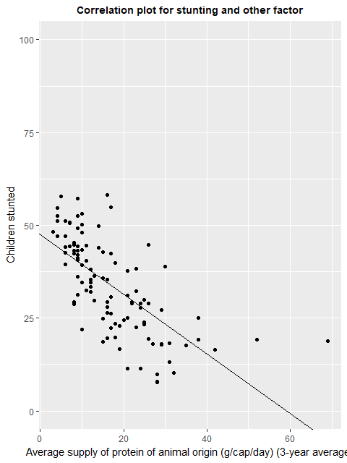
Correlation between average protein supply (animal source) and stunting
Data: FAOSTAT and DHS for 53 countries LMICs (2000-2017)
Source: Nakada JICA
(JICA unpublished 2019)
Notes:
Source of Data from FAOSTAT (FAO Household consumption data- Food security suite of indicators)
Each dot represents one country (Each country has several dots depending on year.)

Slide 46
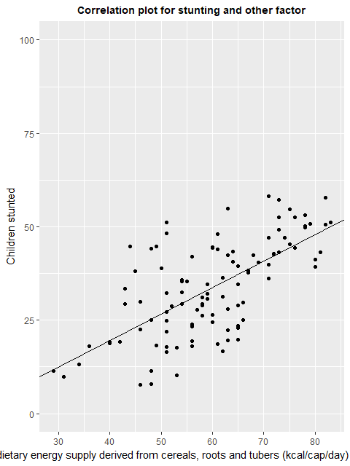
Correlation between dietary energy supply from staples and stunting
Data: FAOSTAT and DHS for 53 countries LMICs (2000-2017)
Source: Nakada JICA
(JICA unpublished 2019)

Slide 47
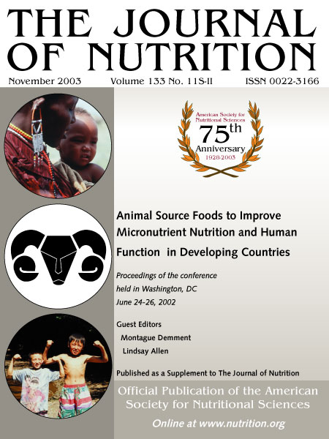

Slide 48
Nutrition Collaborative Research Support Program (CRSP)
Randomized, controlled feeding intervention study of 1st and 2nd grade children assigned to one of four isocaloric feedings:
  Meat added to githeri*
  Milk with githeri
  Githeri with added oil
  Control; no school feeding
Two cohorts from the same schools and the same grades were enrolled exactly one year apart and each followed for 2 years
  N ~ 500 in cohort 1
  N ~ 375 in cohort 2
*githeri: traditional dish of maize, beans, greens
Notes:
Diets were isocaloric (313 Kcals) had githeri: traditional dish of maize, beans, greens as a base but meat group had meat blended in it ( meat was 60-85 g per day)- meat group

Slide 49
Neumann et al. C 2003
Notes:
Raven’s culturally neutral intelligence scores: 15% increase in IQ scores for the meat group
(controlling for baseline scores)

Slide 50
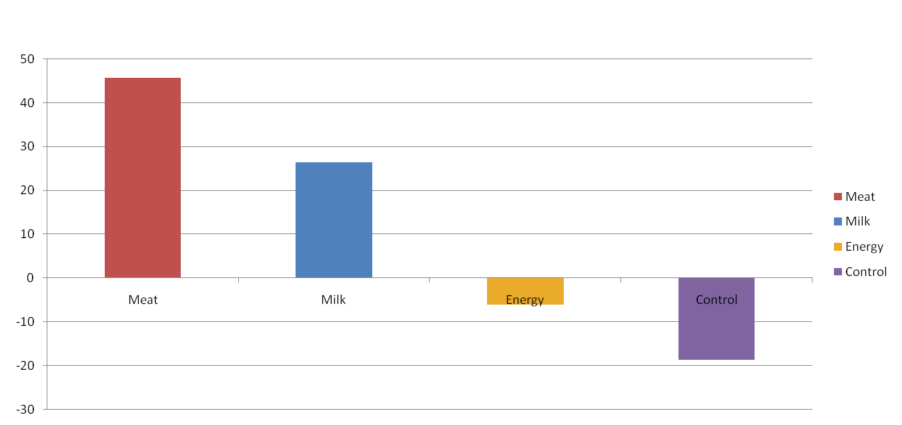
Change in Total Test Scores by Group (over 5 school terms)
Change in total test Scores by Group (over 5 school terms)
*
*
*
*Statistically significant, p < 0.05
Adjusted for age, gender, maternal literacy*, height, home food intake, SES, attendance*
Neumann et al. C 2003
Notes:
Feeding group scores controlled for baseline scores: Meat significantly greater change

Slide 51
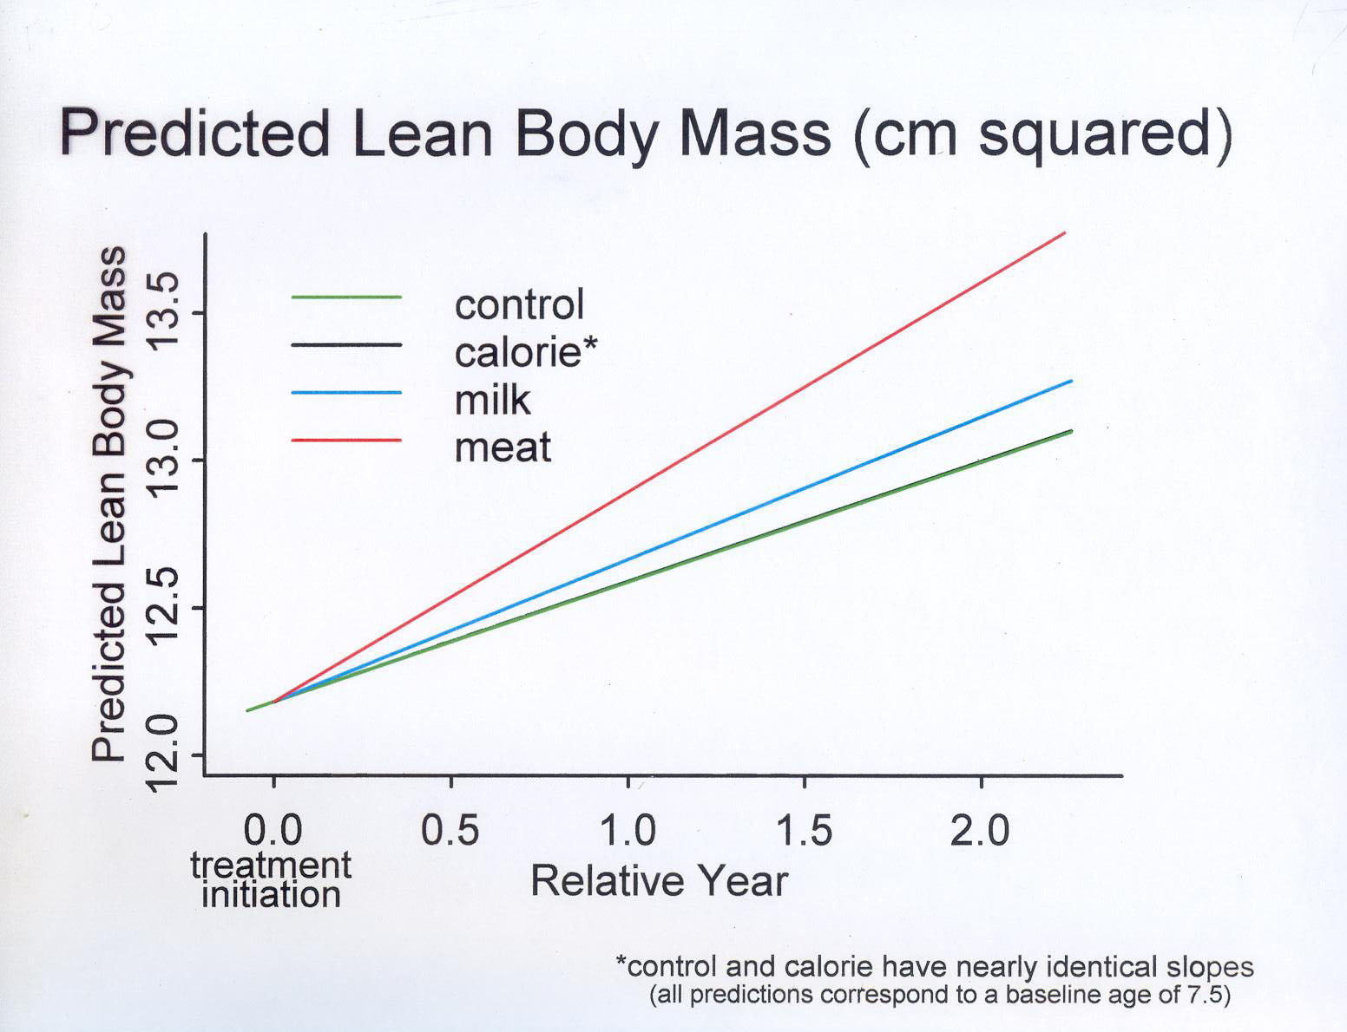
ARM MUSCLE AREA (cm²)
githeri plus oil
Neumann et al. C 2003

Slide 52
Summary
This RCT with meat supplementation showed:
  Increased cognitive and school performance
  Increased high levels of physical activity
  Increased initiative and leadership behaviors
  Increased mid-upper arm muscle area (lean body mass)
  Decreased morbidity
Neumann et al. C 2003

Slide 53
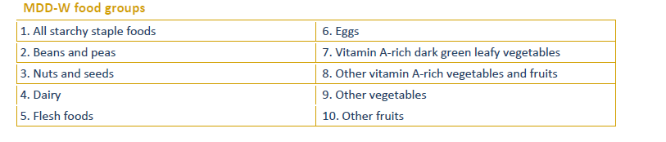
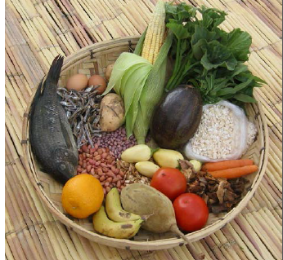
Minimum Dietary Diversity –Women
Indicator to assess diet quality for Women
EU, FAO, FANTA III, USAID, 2014

Slide 54
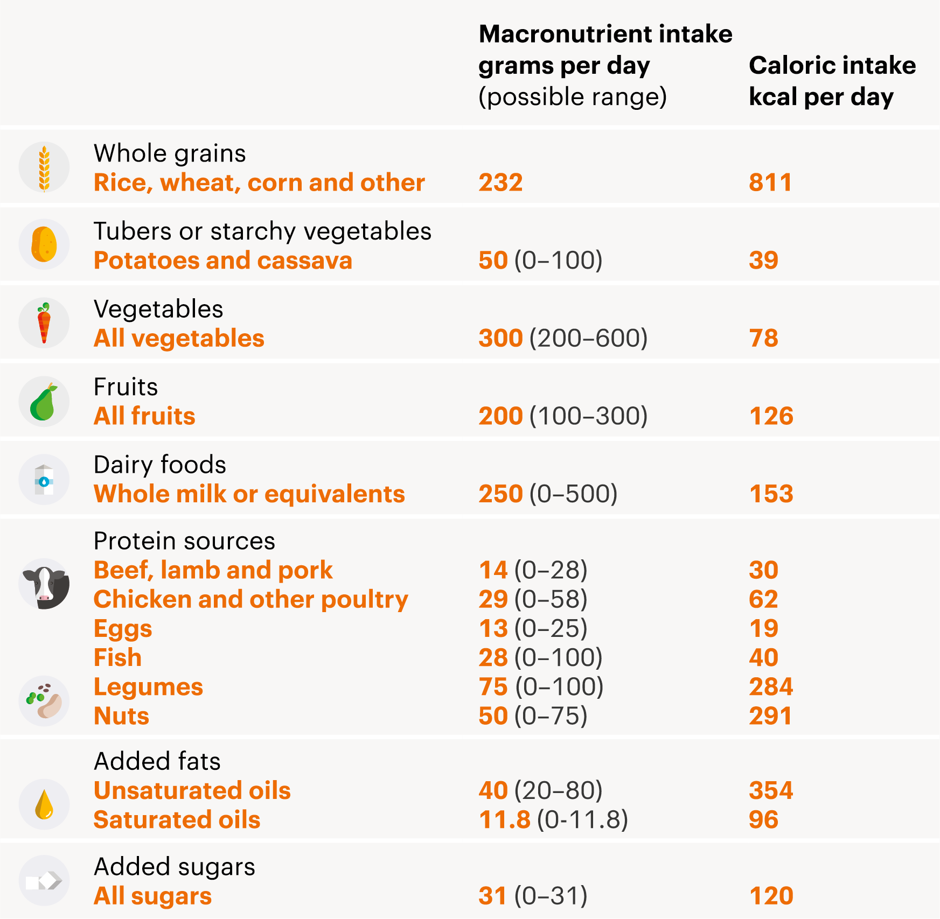

Target 1 – Healthy Diets
2500 kcal/day
EAT-Lancet Commission article on Planetary Healthy Diet

Slide 55
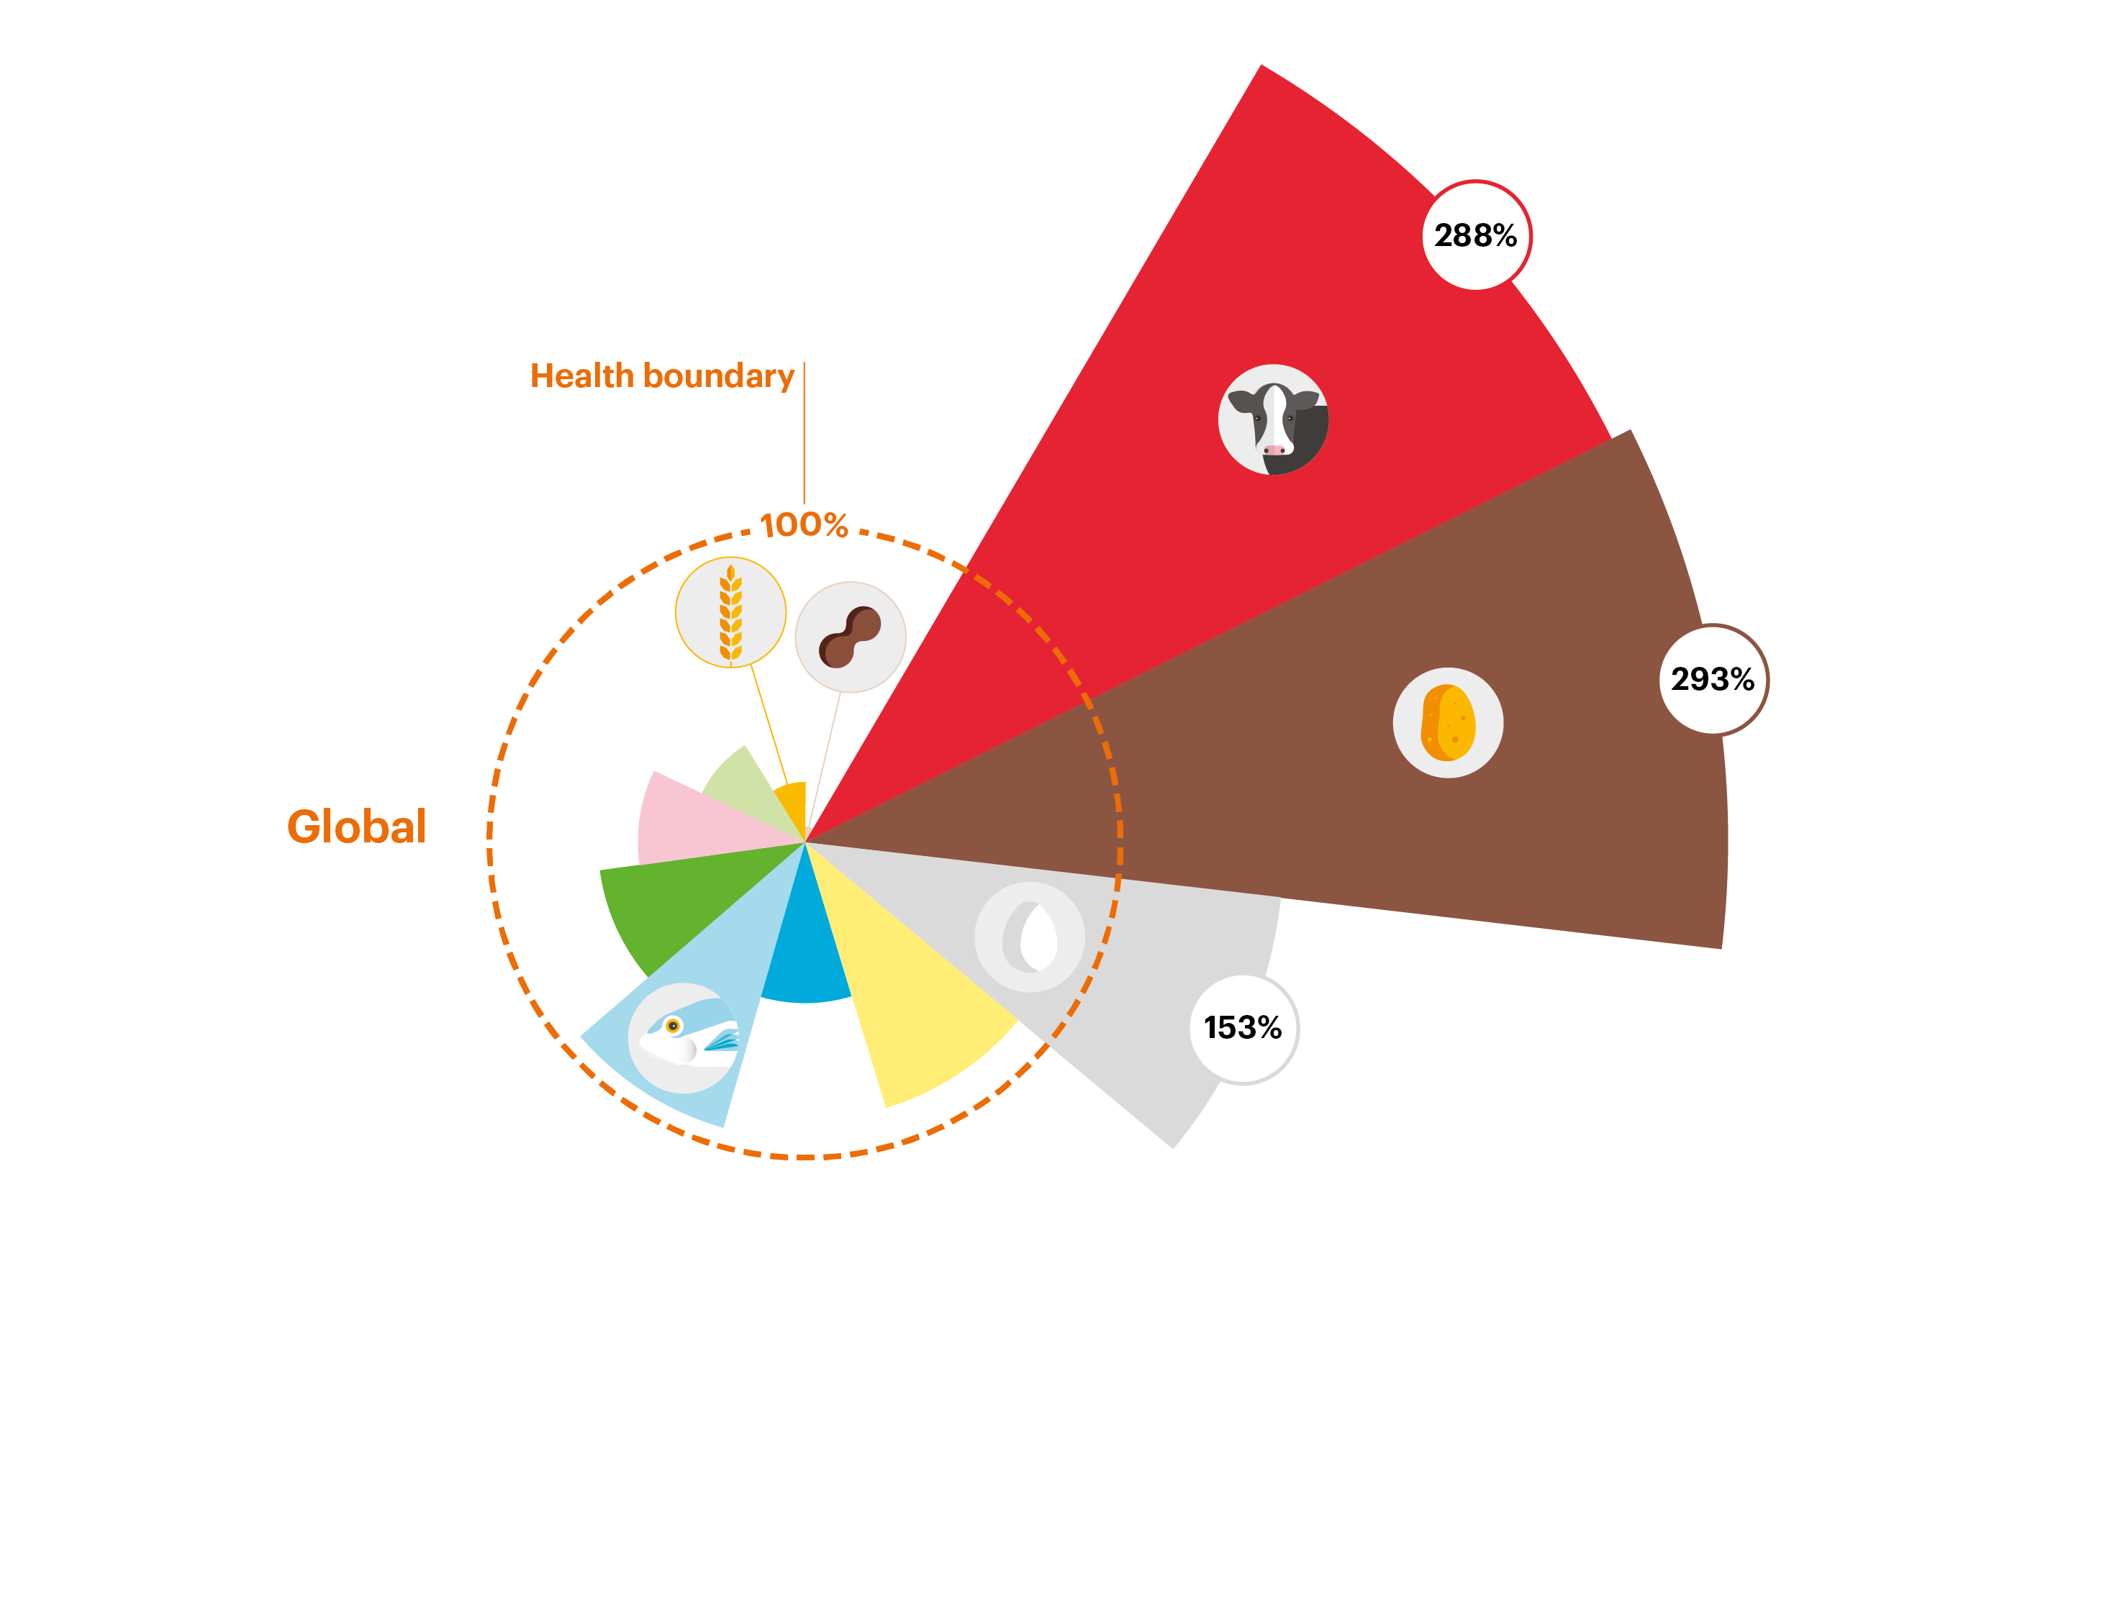
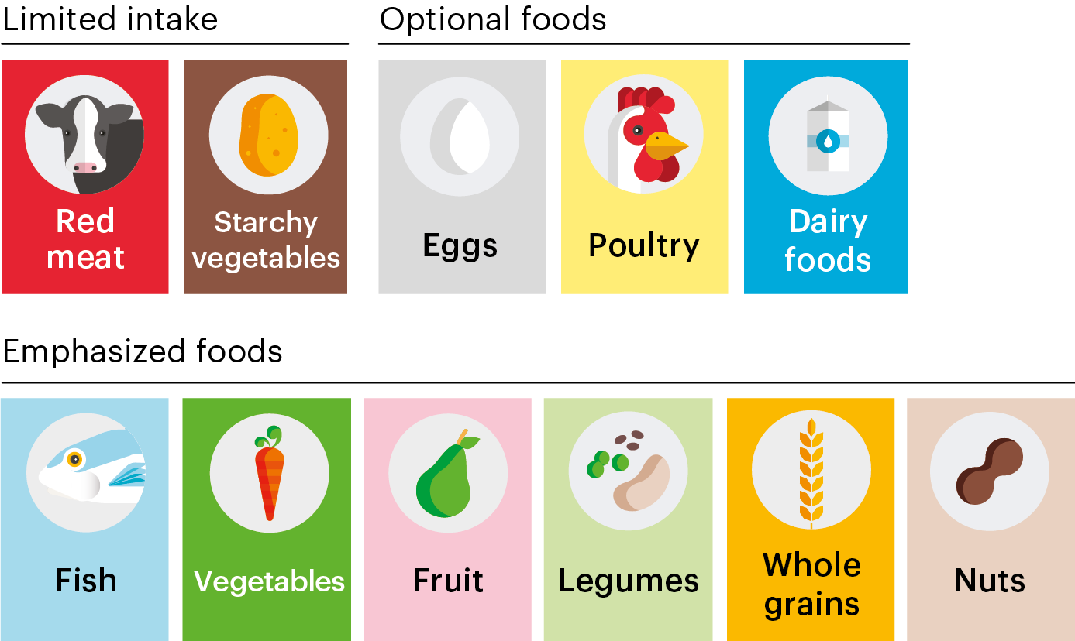
Current Intakes vs
Planetary Health Diet

Slide 56
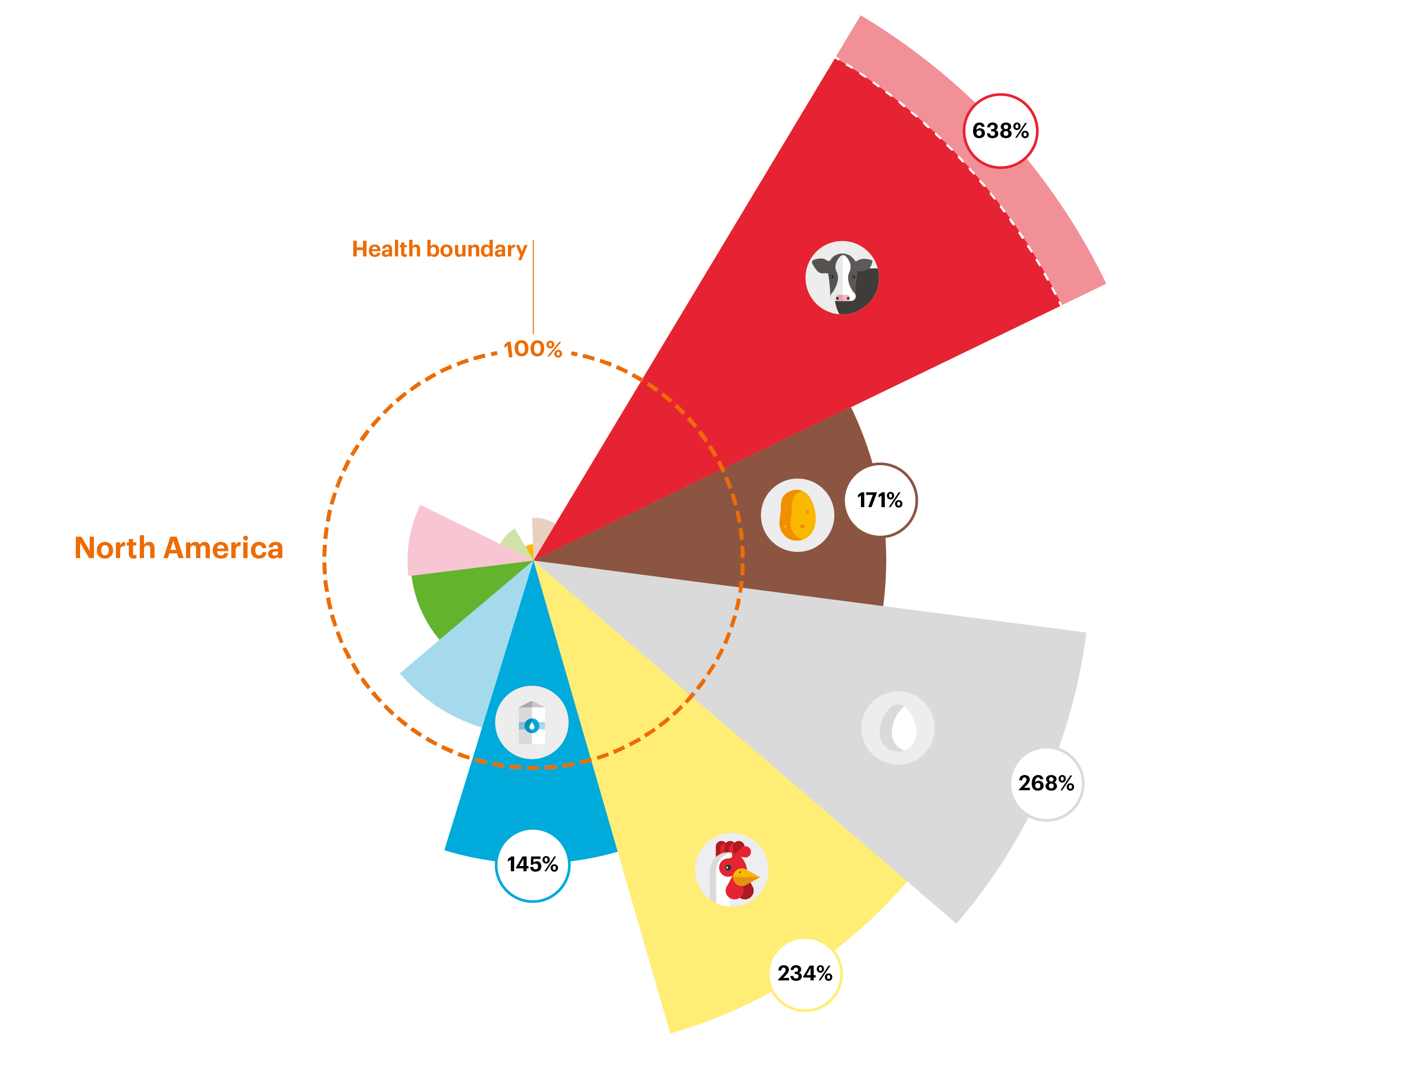
Current Intakes vs
Planetary Health Diet

Slide 57
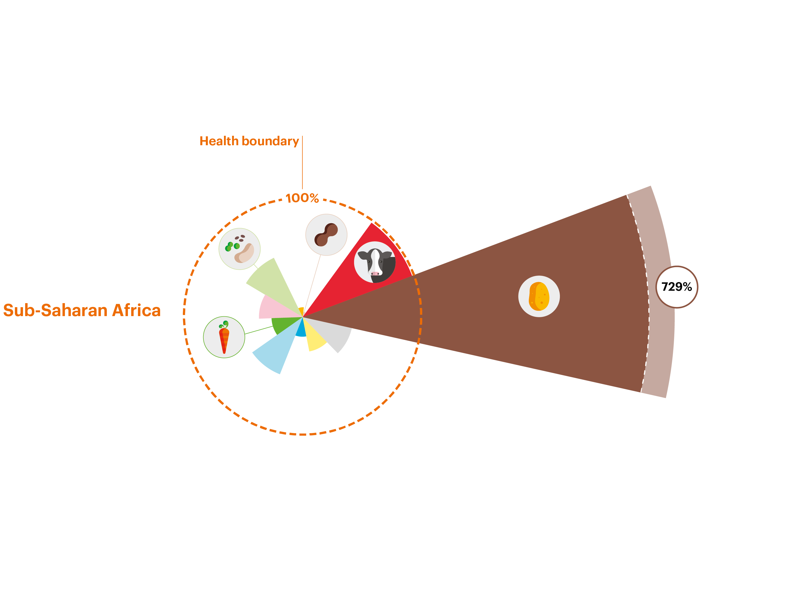
Current Intakes vs
Planetary Health Diet

Slide 58
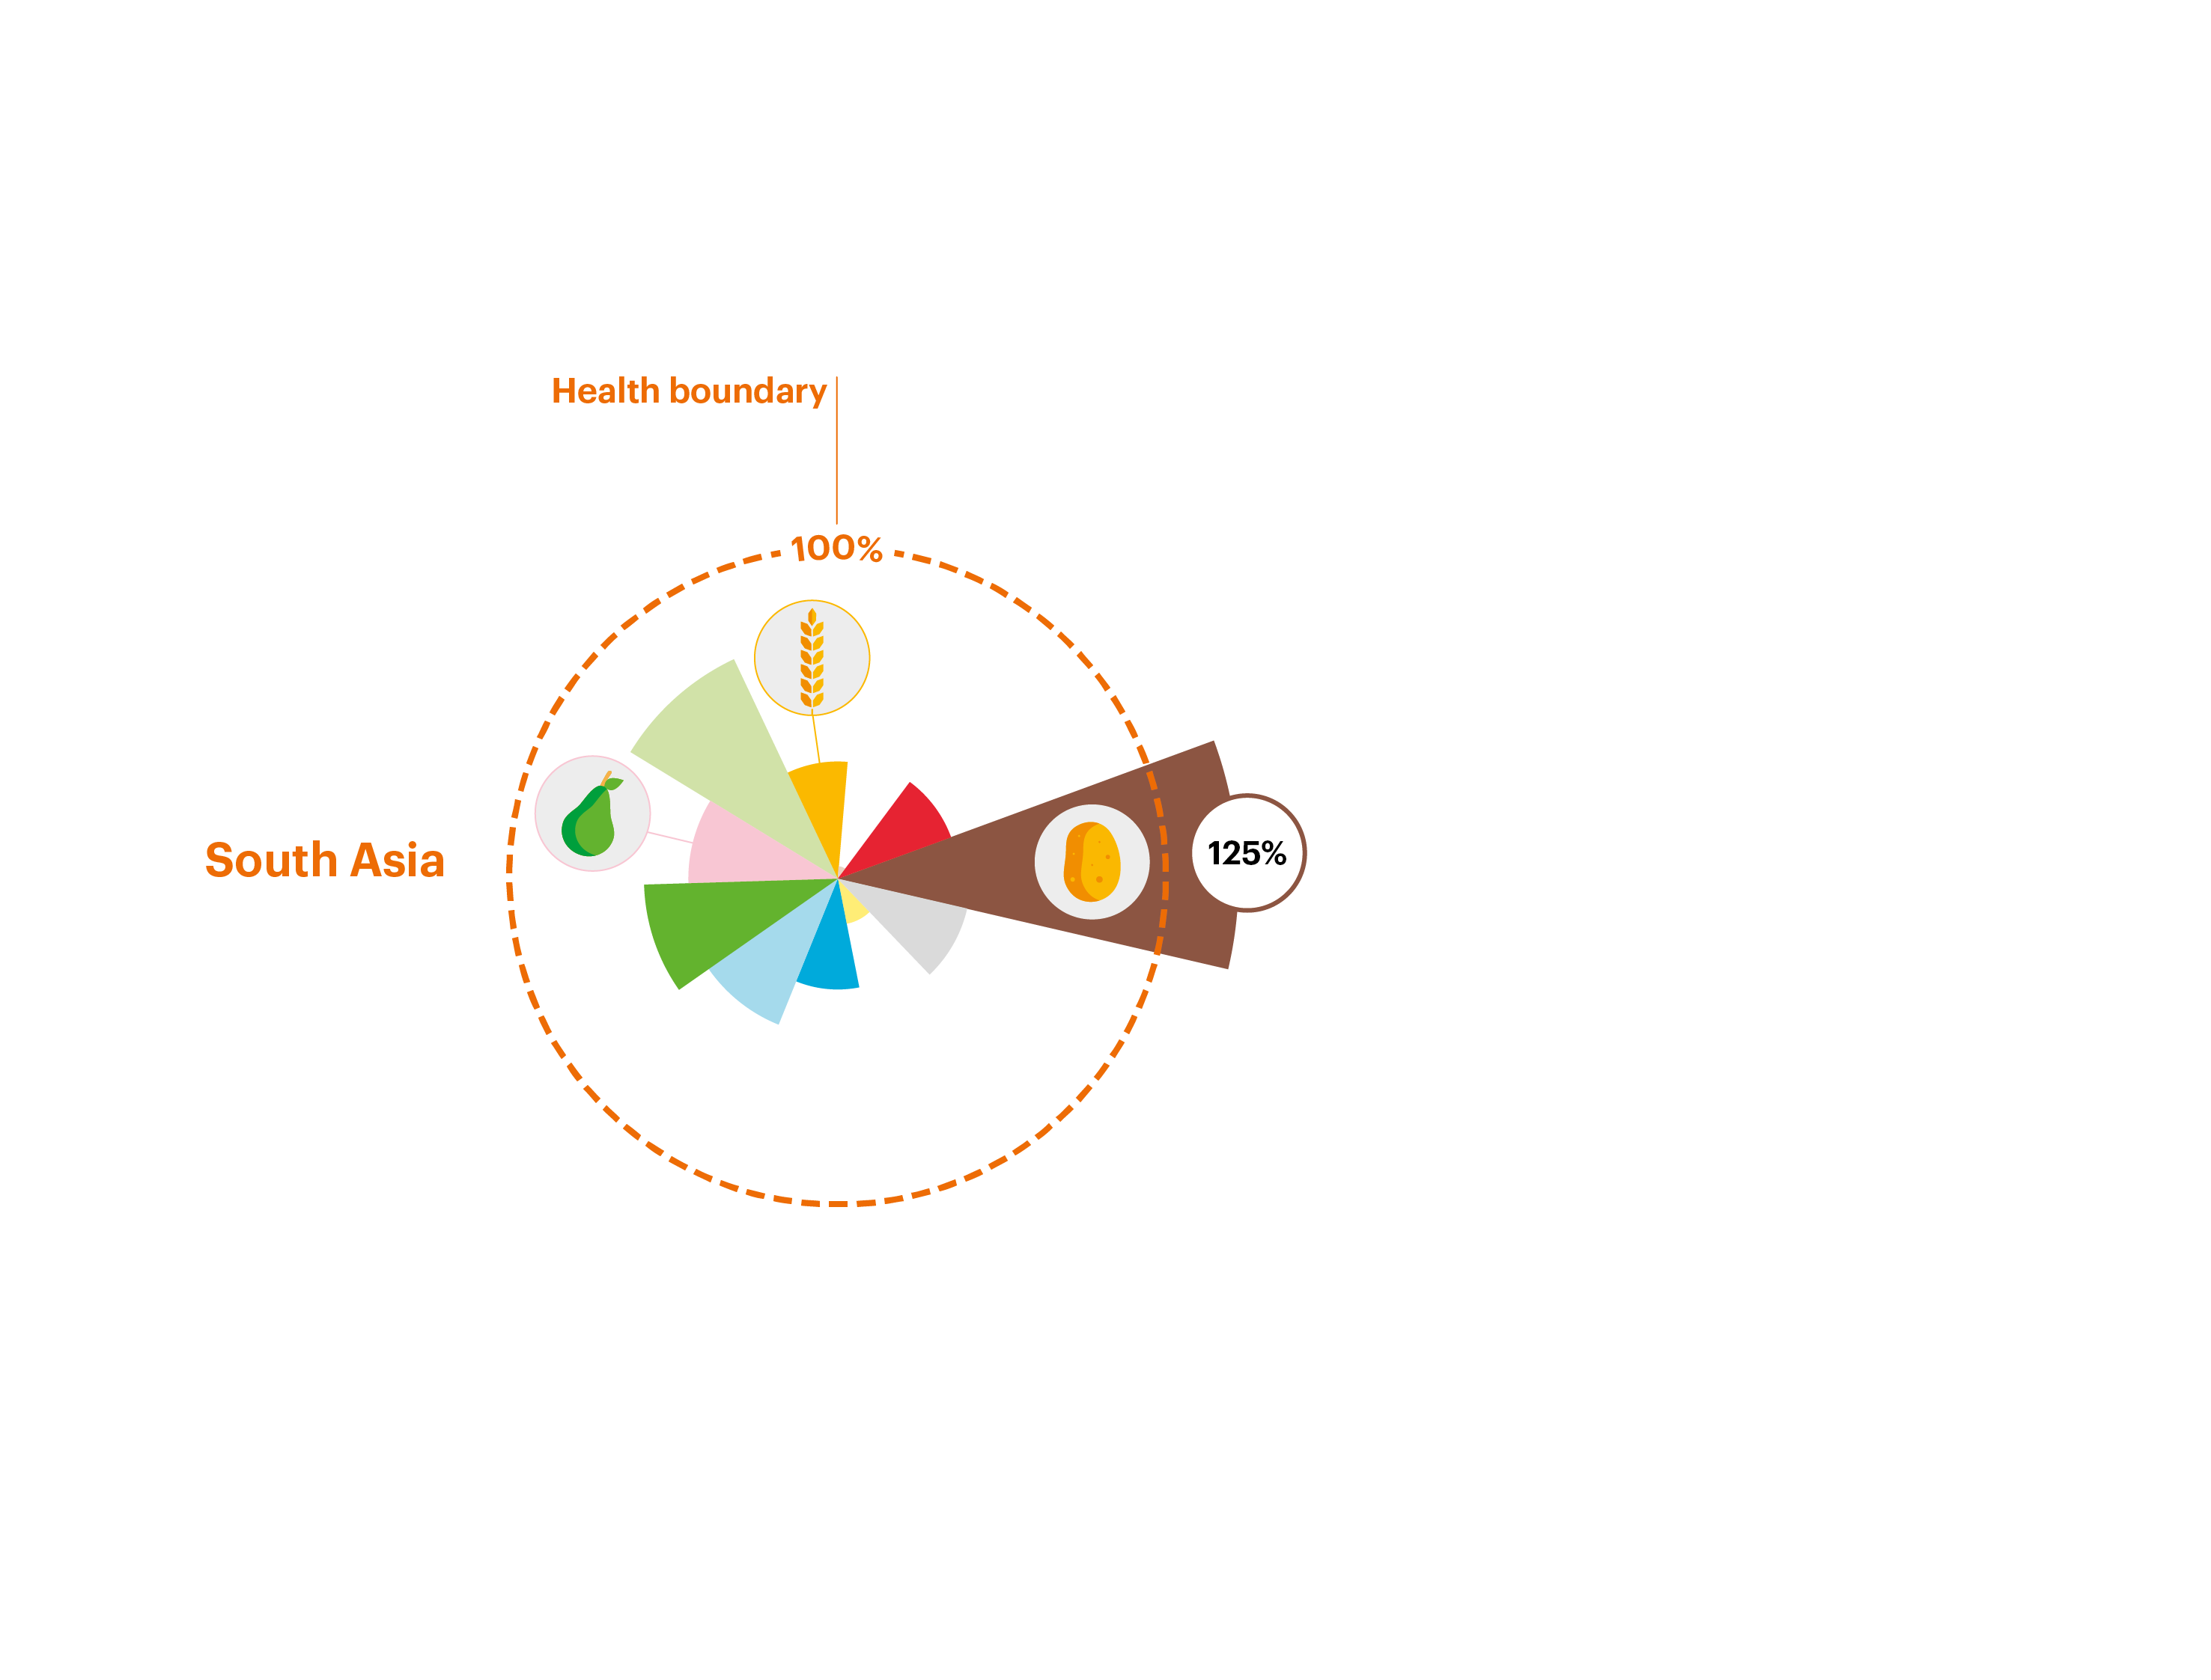
Current Intakes vs
Planetary Health Diet

Slide 59
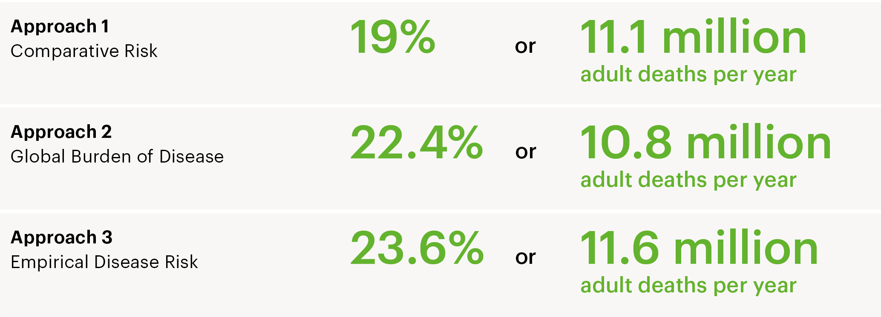
Substantial Health Benefits

Slide 60
Recommendation from EAT-Lancet Commission, January 2019
Transformation to healthy diets by 2050 will require substantial dietary shifts. Global consumption of fruits, vegetables, nuts and legumes will have to double, and consumption of foods such as red meat and sugar will have to be reduced by more than 50%. A diet rich in plant-based foods and with fewer animal source foods confers both improved health and Environmental benefits.

Slide 61
EAT-Lancet Commission 2019: Panel 3: ASF in Sub-Saharan Africa
“ Of the 36 countries with the highest burden of stunting among children younger than 2 years, 21 (58%) are in Africa, and 40% or more children in most of those countries are stunted. This undernutrition is sometimes associated with low consumption of animal source and other protein rich foods.
Because carbohydrate intake is high in many parts of sub-Saharan Africa, promotion of animal source foods for children, including livestock products, can improve dietary quality, micronutrient intake, nutrient status, and overall health.”

Slide 62
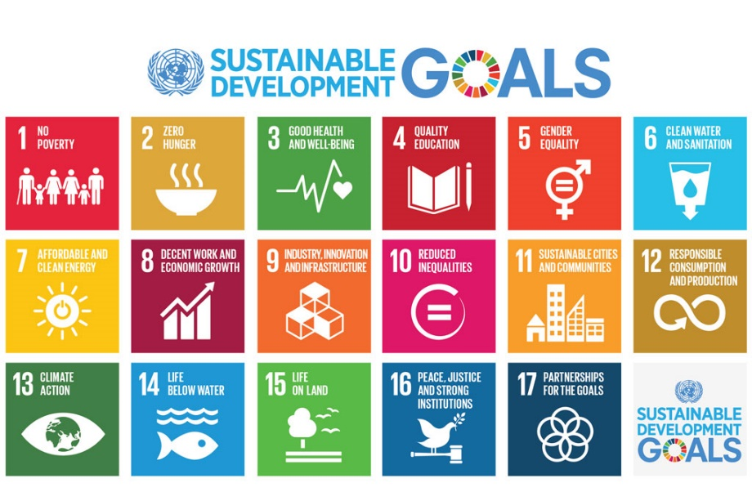
Global Opportunities to transform our food systems
The 2030 Agenda: Sustainable
Development: “we pledge to leave no one behind”

Slide 63
Conclusion
We face massive challenges
We have a huge burden of malnutrition
We have options on how we produce our food for the future
Our food systems are challenged and diets are an entry point
Notes:
Summary:
We are facing massive challenges that will shape the way we live our lives;
We have a huge malnutrition burden
In terms of global food production we can go three ways: BAU, TSS, SSS
Food systems are challenged and need to be fixed; Healthy diet is critical for decreasing malnutrition. We have examples of countries using policies to make impact on the food environment;
Good to have political will and commitment but it is time to act;
Recent Lancet Obesity paper 2019 talks abut Policy inertia (governments are afraid to act do not want to lose votes, businesses are powerful and influence government from making policies that would affect their profits; Consumers do not demand their right to healthey diet and health)
Q&A: Give an example of policy that has led to impact: (MGRS; Iodine)

Slide 64
It is time to transform food system to make nutritious, safe, affordable and sustainable diets available to all.
Animal source foods eaten within recommended levels, fit within a food system transformation that delivers on healthy diets.

Slide 65
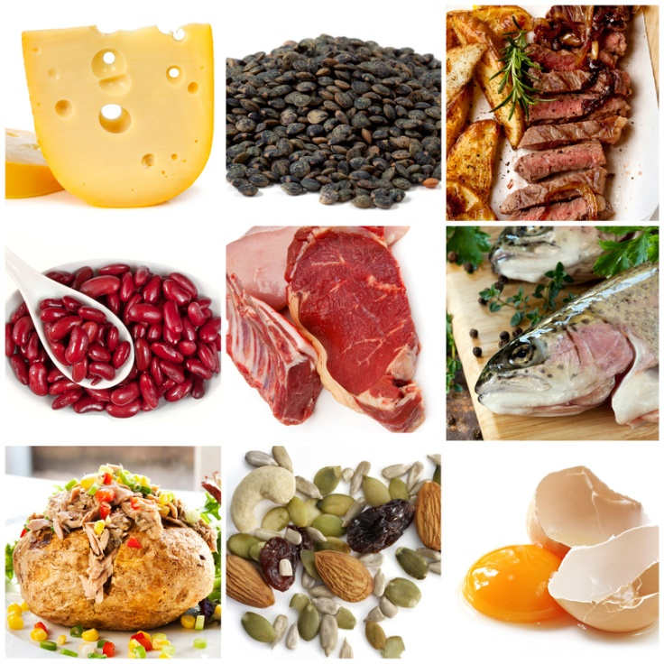
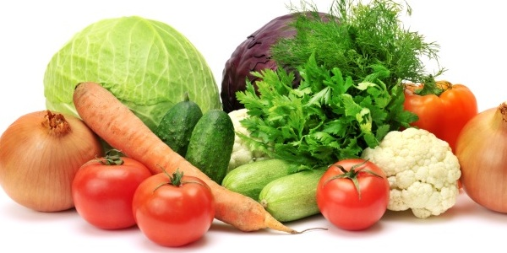
Thank you

